Slide 1
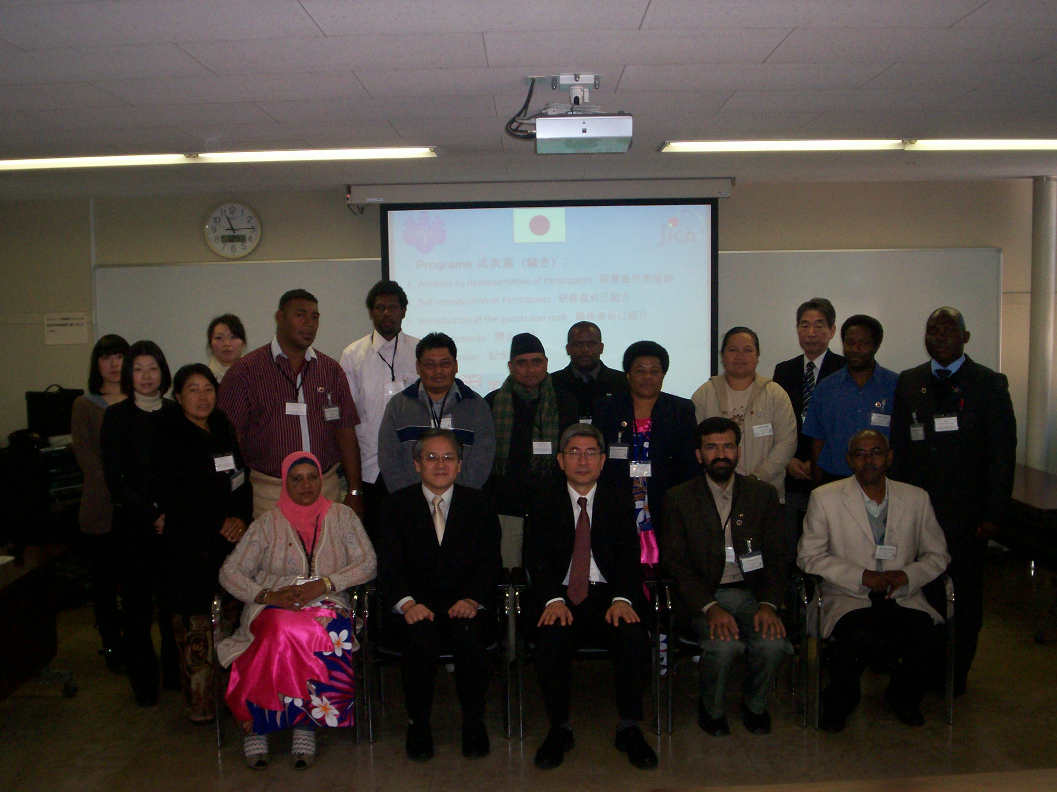
Improving Teaching Methods Of Mathematics in Primary Education
Japan 2012

Slide 2


Action Plan
Antonio Aragon Teacher at Orange Walk Institute for Technical and Vocational Education and Training

Slide 3
Introduction
This is a brief description of what I plan to implement in my institution. I have learnt the importance of using Japanese Problem Solving Approach in the Mathematics classroom. We are in need of new strategies to encourage students to learn thus improving the quality and standard of our students. With the implementation of this action plan my goal can become a reality

Slide 4
Narrative Summary
Title: School’s Enhancement Project
Period: One Year
Target Location: Orange Walk ITVET
Target Group: 65 Students and 5 Teachers from Orange Walk ITVET

Slide 5
Over-all Goal:
The quality and academic level of students from the
Orange Walk ITVET (Pre-Vocational Program) have
improved.
Specific Objective:
Critical Thinking Skills have increased among students
of the Orange Walk ITVET.

Slide 6
My Learning In Japan
Japanese Problem Solving Approach is a process of problem posing, independent solving, comparison and discussion, and, summary and application.
Japanese Problem Solving Approach develops students understanding and allows them to learn for/by themselves. Mathematics motivates and develops students to become independent thinkers and decision makers.
Blackboard writing is done in a systematic way so for students to see the flow of the lesson.
Lesson Study and Lesson Modeling is vey important in improving teaching strategies for teachers, thus allowing them to learn from one another.

Slide 7

OUTPUTS and ACTIVITIES

Slide 8
OUTPUTS
Output 1: Yearly plan is being set in place and being implemented
Output 2: Lessons are more student centered and students’ performance is improved.
Output 3: Students’ attendance and interest in school is improved and an atmosphere of competition is created.

Slide 9
The following committees will be established
Tutoring committee (Extra Classes)
Extra Curricular Activity Committee
Professional Development Committee
Teachers Supervisory Committee

Slide 10
Output 1: Yearly plan is being set in place and being implemented
Activities
< Annual Plan Development>
1.1To review the content matter of subject context being offered at present school.
1.2To solicit training from ministry to set up school Yearly plan.
1.3To conduct training workshops for teachers to complete a yearly plan per subject.
1.4To assign key persons to supervise teachers implementing the newly acquired Yearly Plan and for them to give weekly feedbacks.

Slide 11
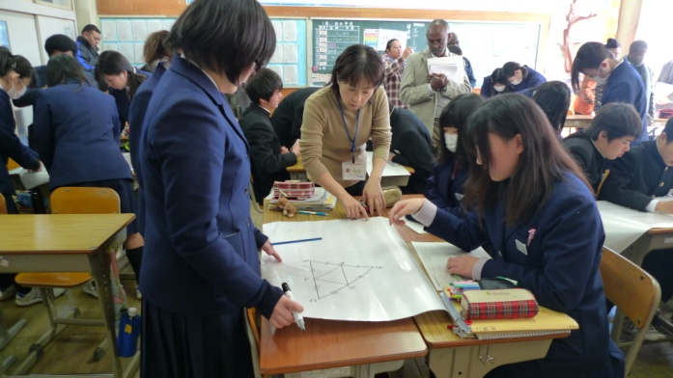
Output 2: Lessons are more students centered and students’ performance is improved
Activities
<Creation of Students Centered Lessons>
2.1Provide key teachers with in-service training in education pedagogy from MOE and Professional Educators.
2.2 Implement in-service training for teachers in education pedagogy within school from teachers that had acquired in-service training from external sources.
2.3 To conduct weekly supervision by Supervisory Committee to get feedback on teachers implementation of what they have acquired from training
2.4Conduct lesson modeling among teachers at least twice per month so teachers can assess each other as a school and get constructive feedbacks from colleagues as a whole.
Teacher serves as a facilitator while students learn and explore
Teshirogi Junior High 2nd year
Inaba Sensei

Slide 12
Output 3: Students’ attendance and interest in school is improved and an atmosphere of competition is created
Activities
< Improvement of Students’ Attendance To School>
3.1Create different clubs for students. ( Pair Tutoring Club, Marching Band Club, School News Paper Club)
3.2Have tutoring classes set for students who may need help on assignments conducted by instructors and tutoring club. (After Classes)
3.3Teachers provide extra-classes on reading and writing English. Set incentives for students to attend these classes. Tutoring club will be included to help with classes.
3.4Create Math Olympiad and Debate Competition within school.

Slide 13
Plan of Operations
Activity | Year 2012 |  |  |  |  |  |  |  |  |  | Year 2013
Month | M | A | M | J | J | A | S | O | N | D | J | F | M
Output 1:Curriculum and yearly plan is being set in place and being implemented
1-1To review the content matter of subject context being offered at present school.
1-2To solicit training from ministry to set up school Yearly Plan.
1-3To conduct training workshops for teachers to complete a yearly plan per subject.
1-7To assign key persons to supervise teachers implementing the newly acquired Yearly Plan and for them to give weekly feedbacks.

Slide 14
Plan of Operations
Activity | Year 2012 |  |  |  |  |  |  |  |  |  | Year 2013
Month | M | A | M | J | J | A | S | O | N | D | J | F | M
Output 2: Lessons are more students centered and students’ performance is improved
2-1Provide key teachers with in-service training in education pedagogy from MOE and Professional Educators.
2-1Implement in-service training for teachers in education pedagogy within school from teachers that had acquired in-service training from external sources.
2-3To conduct weekly supervision by Supervisory Committee to get feedback on teachers implementation of what they have acquire from training
1-4Conduct lesson modeling among teachers at least twice per month so teachers can assess each other as a school and get constructive feedbacks from colleagues as a whole.

Slide 15
Plan of Operations
Activity | Year 2012 |  |  |  |  |  |  |  |  |  | Year 2013
Month | M | A | M | J | J | A | S | O | N | D | J | F | M
Output 3: Students’ attendance and interest in school is improved and an atmosphere of competition is created.
3-1Create different clubs for students. ( Pair Tutoring Club, Marching Band Club, School News Paper Club)
3-2Have tutoring classes set for students who may need help on assignments conducted by instructors and tutoring club. (After Classes)
3-3Teachers provide extra-classes on reading and writing English. Set incentives for students to attend these classes. Tutoring club will be included to help with classes.
3-4Create Math Olympiad and Debate Competition within school.
3-5Divide students in Houses and create an atmosphere of sports competition

Slide 16
Conclusion
The problem that we face in my country is that majority of teachers do not process education pedagogy. Textbooks are not standardized and this allows schools to used different textbooks. Many of our children are dropping out of school due to lack of interest.
My intentions is to make students develop that interest to stay in school and this can be accomplished by teachers better preparing themselves for the delivery of lessons. By the implementation of the Japanese Problems Solving Approach students will be able to appreciate mathematics more and thus develop that interest in school.

Slide 17


THANK YOU
japan
Belize

