Slide 1

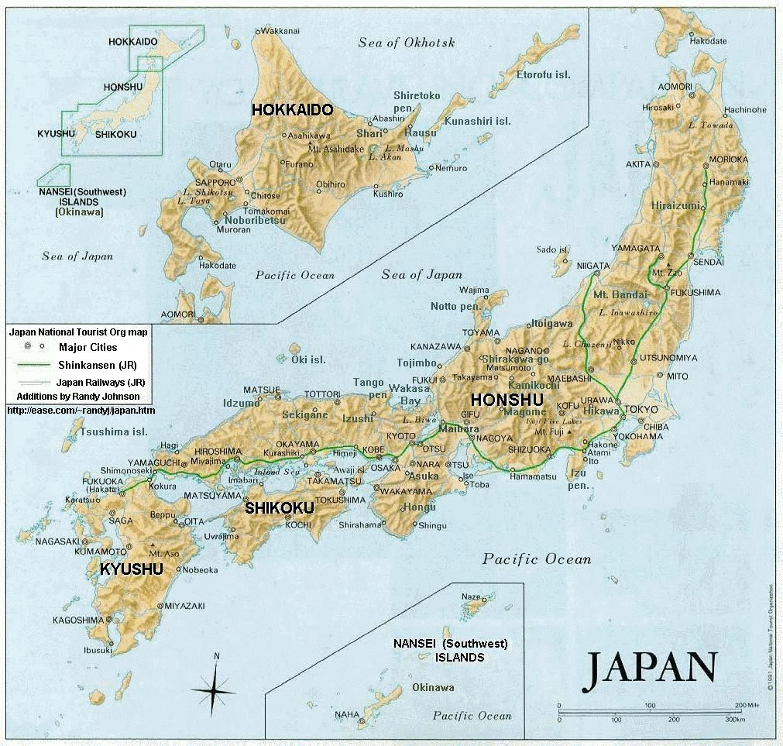


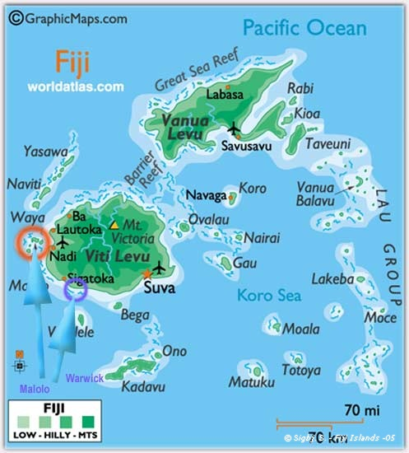
Action Plan
2012
The J1100711 Group Training Course on
“IMPROVING TEACHING METHODS IN MATHEMATICS IN PRIMARY EDUCATION”
Name: Sofia Shireen Ali
Country : Fiji Islands
Organization: Fiji National University
School of Education
Department of Primary Education
Position : Lecturer Language /Mathematics Education

Slide 2

Narrative Summary
TITLE: Using of Problem Solving Approach in Teaching and learning of Mathematics in Primary School.
Period | April 2012 to September 2012
Target Location | Fiji National University, Lautoka Campus
Target Group: | Primary Mathematics Education Lecturers (PML) Primary school Teachers(PST)

Slide 3
Overall Goal
Primary teacher trainees graduating from Fiji National University will be able to teach primary Mathematics using problem solving approach together with the primary schools teachers (PST) of Lautoka will be able to teach in using problem solving approach and carrying out lesson study in their classrooms.
Specific Objectives
Primary mathematics lecturers of Fiji National University can train the primary teacher trainees and primary school teachers (PST) of 5 selected schools using Problem Solving Approach and carry out lesson Study in Mathematics in the classrooms when they are on teaching Practice.

Slide 4
Learning in Japan
-Style of writing daily report
-Japanese Text Book
-Japanese Mathematics Content for
Elementary School
-Problem Solving Approach
Open-Ended Approach
Hands on Approach
Origami
-Developing 3 ways of Thinking
- Lesson Study
-Disaster management ,Evacuation
Procedures

Slide 5
Output and Activities
Output 1 : Fiji National University (FNU) personals and authorities grant approval to implement the project at FNU and also in 5 selected primary schools in Zone C1 Lautoka. Ministry of Education grants approval to use the selected 5 schools in Zone C1 Lautoka
Activity 1.1 :Primary Mathematics Education Lecturers (JICA Trainee) prepares proposal for the FNU Council for approval to carry out the project implementation at 5 selected primary schools in Zone C1 Lautoka
Activity 1.2 : Primary Mathematics Education Lecturers (JICA Trainee) seeks permission from Ministry of Education(MOE) to conduct lesson study in one of the schools that is in 5 selected schools in Zone C1 Lautoka district
Activity 1.3 : Primary Mathematics Education Lecturers (JICA Trainee) seeks permission from the Head Teacher of Natabua High School and 5 selected schools in Zone C1 Lautoka.
Activity 1.4: Lecturer (JICA Trainee) conducts meeting with the Primary Mathematics Education Lecturers and (PST)and discusses the proposal(Project)
Activity 1.5: Primary Mathematics Education Lecturers(JICA Trainee) will set up a committee for the 5 selected Lautoka primary Schools Zone C1 for the lesson Study.
Activity 1.6 : Primary Mathematics Education Lecturers(JICA Trainee)will give a name to their committee and set up a training Schedule with time and venue.

Slide 6
Output and activities cont’d
Output 2:Training Manual on the lesson study/problem solving approach is developed and distributed to the PMEL and Primary school Teachers (PST) of 5 Selected schools in Zone C1 Lautoka.
Output 3 : FNU Primary mathematics Education lecturers (PMEL) can provide primary teacher trainees(PTT)
with problem solving approach together with the primary school teachers of the 5 selected schools in Zone C1 Lautoka.

Slide 7
Output and activities cont’d
Activity 3.1 :Primary Mathematics Education Lecturers(JICA Trainee) Prepare lecture notes on “problem solving approach”
Activity 3.2: Primary Mathematics Education Lecturers(JICA Trainee) conduct lecture on “problem solving approach” with PMEL and PST OF 5 selected schools.
Activity 3.3 :Primary Mathematics Education Lecturers(JICA Trainee) conduct workshops on “problem solving approach” with PMEL and PST of the 5 selected schools

Slide 8
Output and activities cont’d
Output 4 :Primary Mathematics Education Lecturers (JICA Trainees) will train PMEL and PST 5 selected schools on "open ended approach
Activity 4.1: Primary Mathematics Education Lecturers (JICA Trainee) will prepare lecture notes on “open ended approach”.
Activity 4.2 Primary Mathematics Education Lecturers (JICA Trainee) will conduct lectures and give out readings from books “Open ended approach” with primary mathematics Education Lecturers.
Activity 4.3 :Primary Mathematics Education Lecturers (JICA Trainee) conduct workshops on “open ended approach” with Primary Mathematics Education Lecturers at FNU and PST of 5 selected schools in ZONE C1 Lautoka
Output 5 : Primary Mathematics Education Lecturers (JICA Trainee) will train PMEL and PST of 5 selected schools on" hands on approach”
Activity 5.1: Primary Mathematics Education Lecturers (JICA Trainee) will prepare lecture notes on “hands on approach”
Activity 5.2: Primary Mathematics Education Lecturers (JICA Trainee) will conduct lectures and give out readings from books on “hands on approach” with PMEL and PST of 5 Zone C1 schools in Lautoka
Activity 5.3 : Primary Mathematics Education Lecturers (JICA Trainee) conduct workshops on “hands on approach” with PMEL and PST of 5 selected Zone C1 schools in Lautoka

Slide 9
Output and activities cont’d
Output 6 : Primary Mathematics Education Lecturers (Jica trainee) will Train the PMEL and PST of 5 selected schools in Zone C1 Lautoka on lesson study
Activity 6.1 : Primary Mathematics Education Lecturers (JICA Trainee)will provide videos on lesson study to the PML and PST of the 5 selected schools of Zone C1 Lautoka who will observe “lesson study videos” on problem solving
Activity 6.2 : Primary Mathematics Education Lecturers (JICA Trainee) will have discussions based on the observation of the video of lesson study on problem solving with PMEL and PST of the 5 selected schools of Zone C1 Lautoka..
Activity 6.3 : Primary Mathematics Education Lecturers (JICA Trainee) prepares lecture notes for board preparation through the notes taken by the lecturers in Japan.
Activity 6.4 : Primary Mathematics Education Lecturers (JICA Trainee) Conduct workshops on board preparation with PMEL and PST of the 5 selected schools in Zone C1 Lautoka
Activity 6.5 : Primary Mathematics Education Lecturers (JICA Trainee) develops a lesson plan for lesson study at FNU
Activity 6.6 : Primary Mathematics Education Lecturers (JICA Trainee)models the lesson study to the FNU PMEL and PST of the 5 selected schools in Zone C1 Lautoka

Slide 10
Output and activities cont’d
Output7 :Primary Mathematics Education Lecturers (Jica trainee)can develop 3 model lesson plans for Primary Mathematics Grade 1,3,6
Activity 7.1 : Primary Mathematics Education Lecturers (JICA Trainee) studies the class1,3 ,6 mathematics curriculum
Activity 7.2 : Primary Mathematics Education Lecturers (JICA Trainee)selects one concept and prepares a lesson plan and resources
Activity 7.3 : Primary Mathematics Education Lecturers (JICA Trainee)implements lesson study 1 at the selected school with the PMEL and one of the 5 selected schools in Zone C1
Activity 7.4 : Primary Mathematics Education Lecturers (JICA Trainee)and the teachers of the selected school discuss the presented lesson
Activity 7.5 : Primary Mathematics Education Lecturers (JICA Trainee) modifies the lesson study 1
Activity 7.6 : Primary Mathematics Education Lecturers (JICA Trainee) implements the modified lesson on concept 1 to the one of the 5 selected schools in zone c1
Activity 7.7 : Same activities can be repeated for the other two lessons

Slide 11
Output and activities cont’d
Output 8 : Primary Mathematics Education Lecturers (JICA Trainee) Introduce problem solving in the Primary
Mathematics Education Units and in the 5 selected Primary Schools Zone C1 Lautoka.
Activity 8.1 :Primary Mathematics Education Lecturers (JICA Trainee)prepare course outline, course materials and assignments to accommodate problem solving approach at FNU and can be implemented in the 5 selected Primary Schools Zone C1 Lautoka.
Activity 8.2: Evaluation form given to 5 selected PST in regards to their training and follow up and follow through will Continue.

Slide 12
Problem-solving Approach lesson
Understand a given problem.
Plan an approach and process to solve.
Think in logic (think by themselves).
Explain one’s idea and listen other’s (Group discussion)
Summarize contents
Practice
A School with Dreams and Joy Power Point Presentation Slide 4. Presented by Keiya Sugita

Slide 13
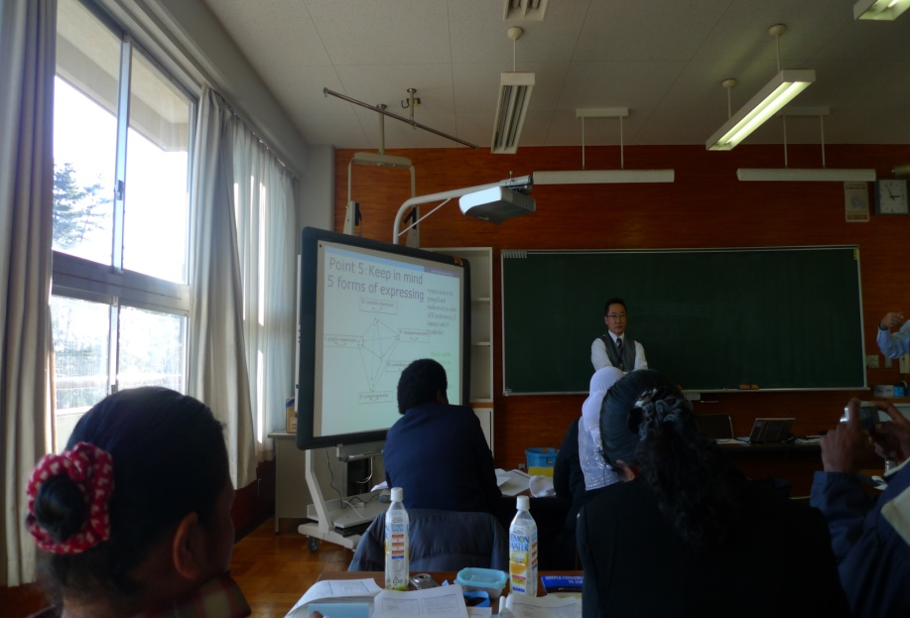
Japanese Problem Solving Approach
Develops students’ understanding and allows them to learn for/by themselves
Children explore many possible solutions
Professor Keiya Sugita Explaining the Problem Solving Approach

Slide 14
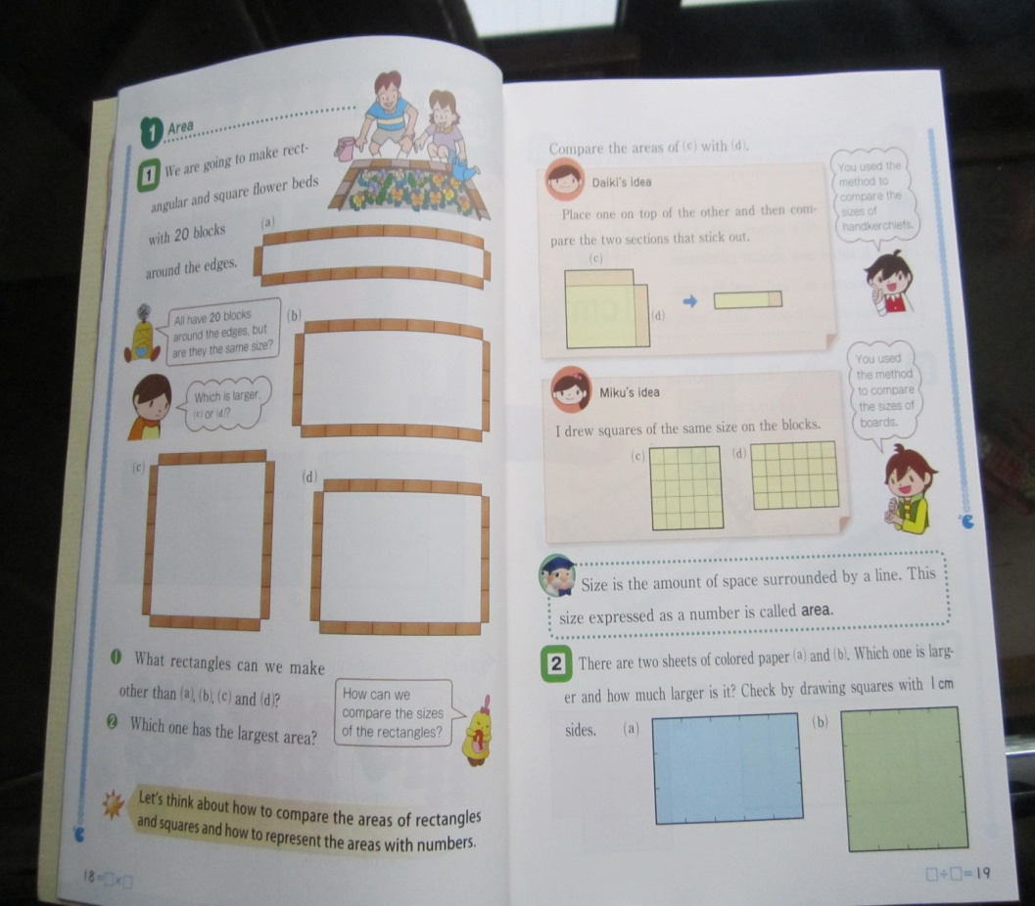
Example of Problem Solving Approach
Task
Problem Solving
Many ways
Compare and Select Solutions for developing appropriate ideas
Problem
(Isoda,M & Murati, Grade 4, Pages 18 and 19)

Slide 15
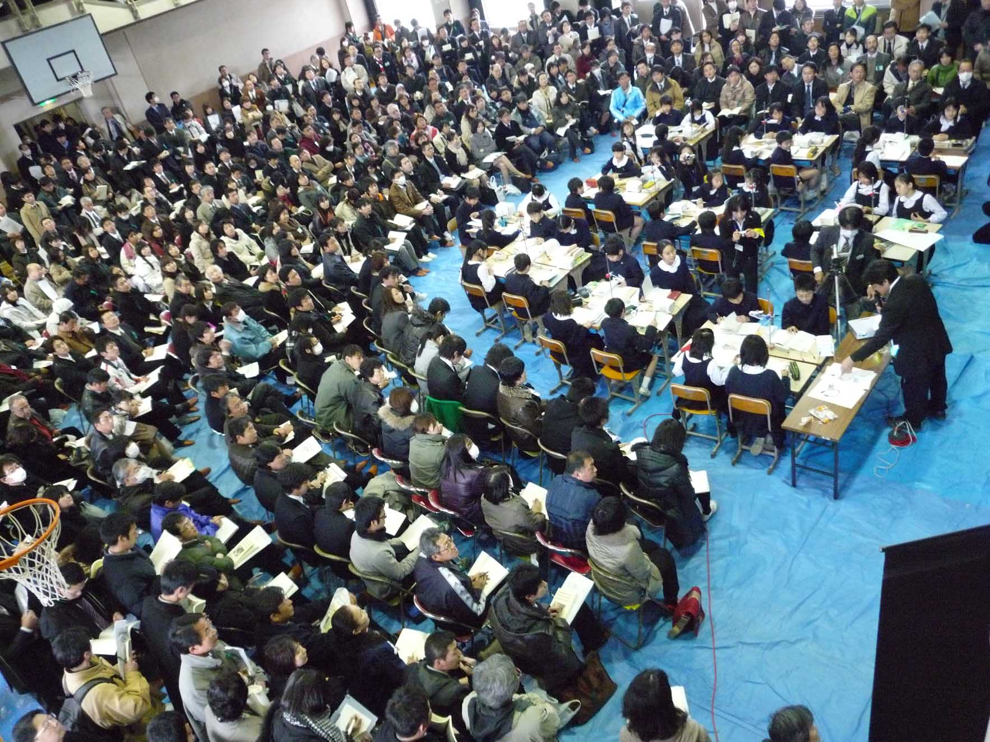
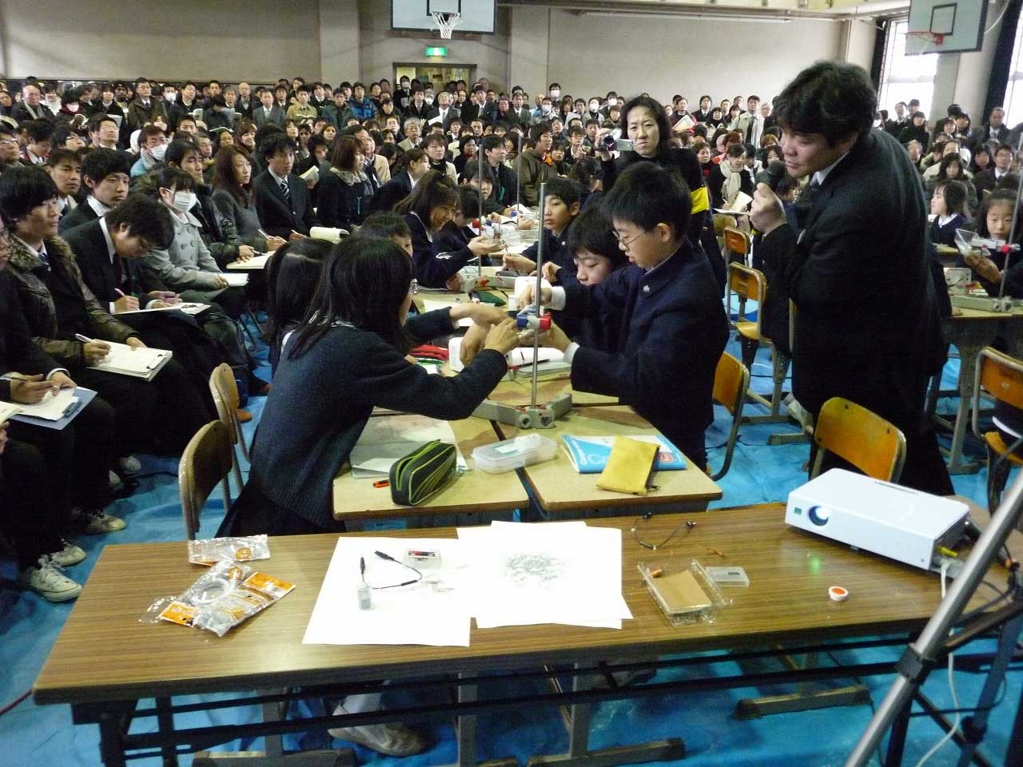
What is lesson study community?
Lesson study is plan, do and see activities with various groups. In Japan, products of lesson study are shared through the books and Journals of lesson study. Their PCK is integrated and unified as teachers’ theories for teaching mathematics..
Theories of Education
Participating Teachers
Lesson Study
Teacher
Subject M.
Theory of Mathematics
Children
Professor Isoda, M. Jan 2012 Lesson Study for Curriculums in Philippines

Slide 16
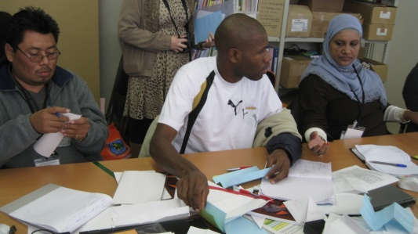
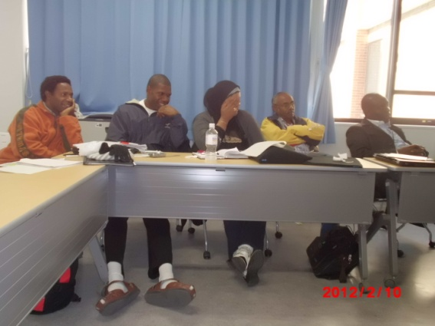
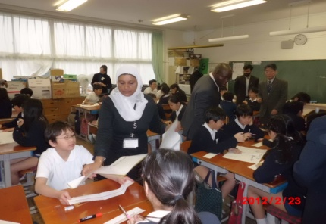
Process of Lesson Study
Study of teaching materials (PLAN) Identification of theme, compilation of lesson plan)
Lesson Discussion Meeting (see) (Lesson evaluation and reflection)
Lesson Study (Do) (Implementation of the lesson and observation)
Group B Planning of Lesson
Lesson Discussion
Group B Demonstration Lesson
Professor Isoda, M
Ref: Japanese Lesson Study in Mathematics;Its Impact Diversity and Potential for Educational Improvement,Isoda,M.,etal;Stephens.M, Ohara.Y, Miyakawa.T ,Page201 (2007)

Slide 17
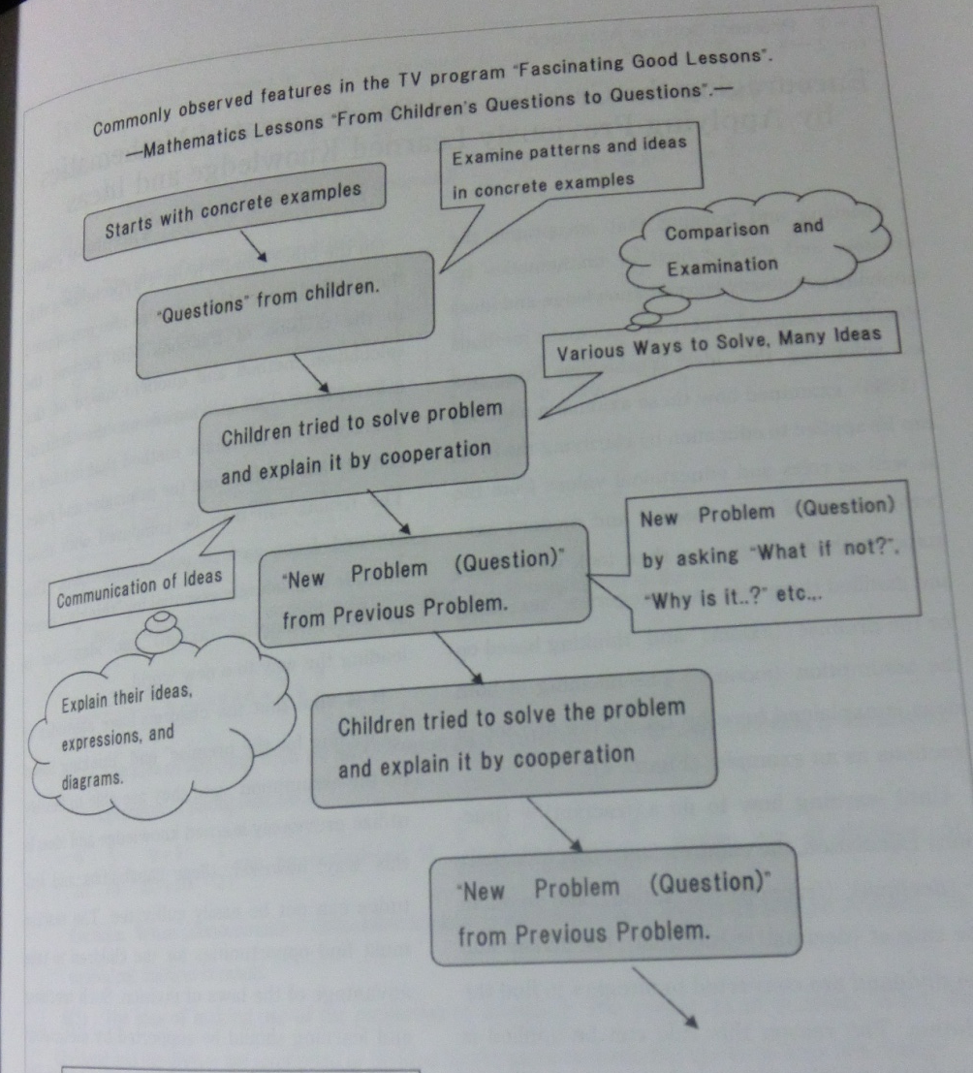
Lesson Plan Design
(1) Concrete examples
(5) Solve in group (sharing)
(2) Questions from children
(6) New problem posed built upon the previous problem
(3) Solve in groups (sharing)
(4) New problem posed built upon the previous problem
(7) Summary
Ref: Special Issue (EARCOME 5) Mathematics Education Theories for Lesson Study: Problem Solving Approach and the Curriculum through Extension and Integration, Journal of Japan Society of Mathematical Education Pag13,(10/08/2010)

Slide 18

D-book Resources on-line
Math-info.criced.tsukuba.ac.jp/museum/dbook_site/
Math-info.criced.tsukuba.ac.jp/museum/dbook_site/APEC-sampleG5/files/Etext.html
www.youtube.com/watch?v=GZ3yC8haws

Slide 19
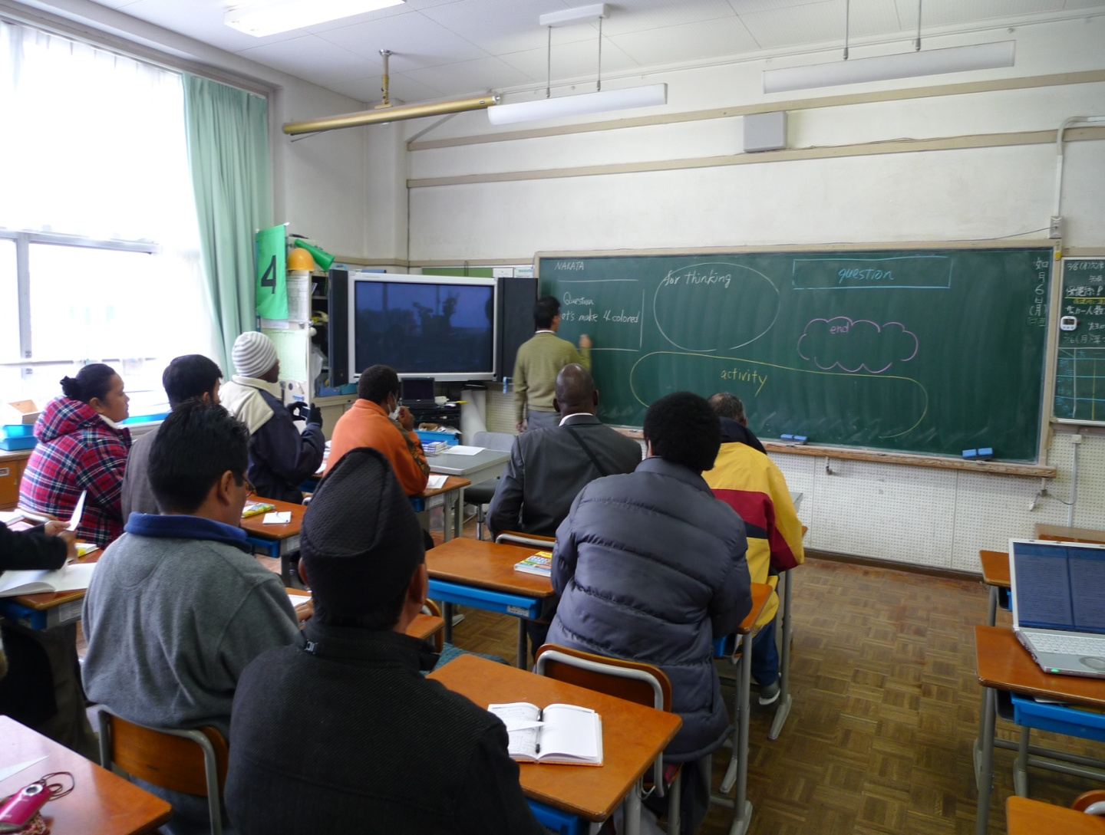
Blackboard Writing in Math Lessons
JICA’s Participants attend a session on Blackboard Writing for Mathematics Lessons
Nakata Sensei giving a lecture on blackboard writing

Slide 20
Japanese Blackboard Writing
By Professor Yamamoto
Professor Yamamoto
Wrap Up
Problem
Children’s presentations. Use for students activities
Things related to perspective. Students Expressions
Use for Drills
Do not erase anything from the blackboard until end of lesson

Slide 21
Blackboard Writing in Math Lessons
JICA’s Participants attend a session on Blackboard Writing for Mathematics Lessons
Nakata Sensei giving a lecture on blackboard writing

Slide 22
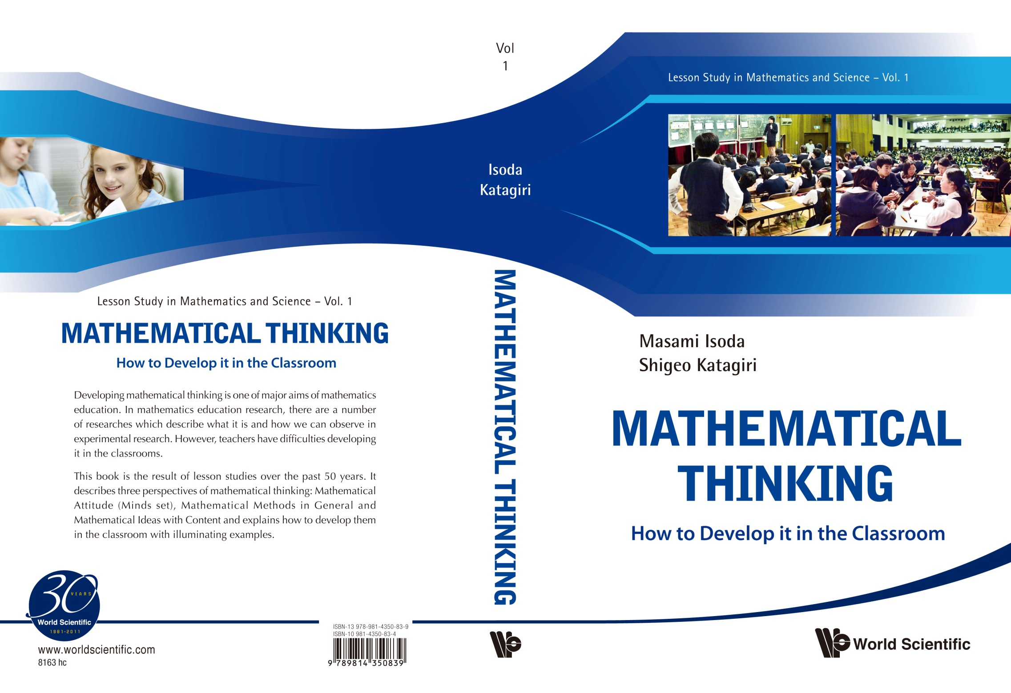
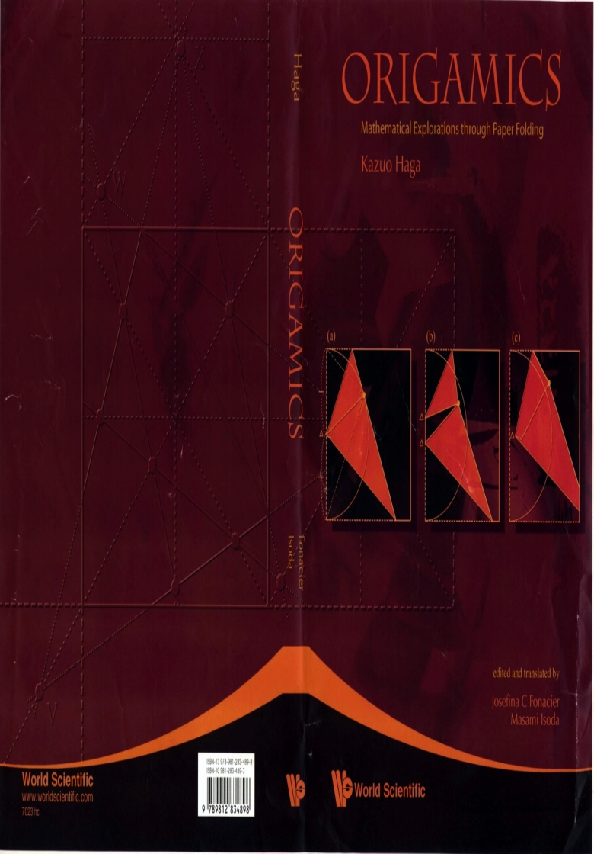
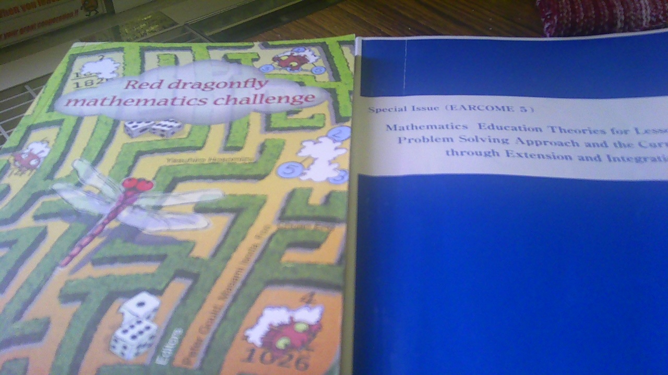
Hands on Approach

Slide 23
My Next Step?
Include problem solving as the focus of math lessons in the teaching practicum of 2013 for 2nd year teacher trainees (one whole term)
MY HOPE AND FUTURE
First set of PST from the 5 selected schools in Zone C1 Lautoka who will be implementers in another 5 schools.

Slide 24
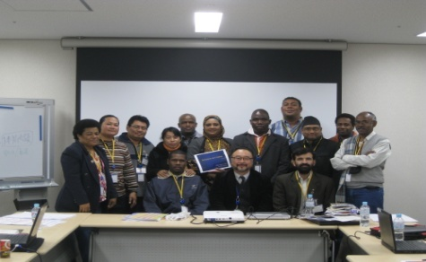
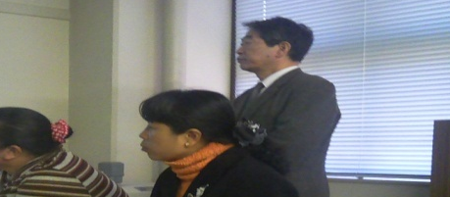
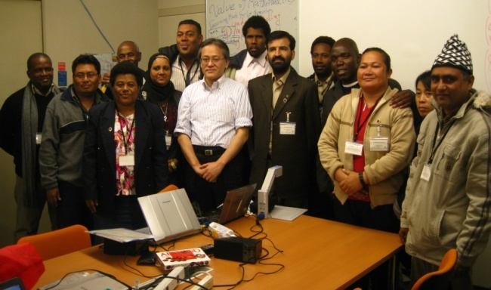
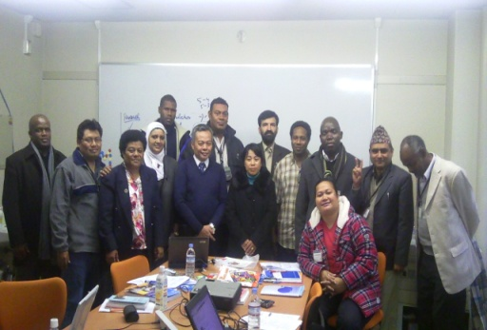
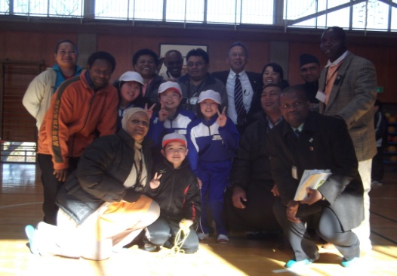
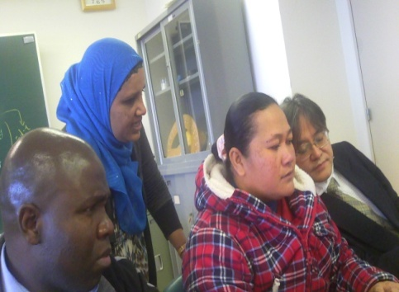
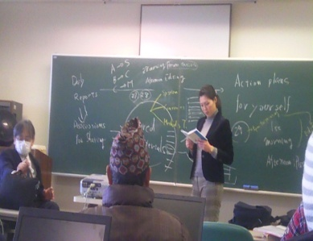
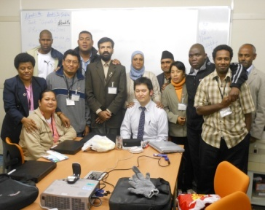
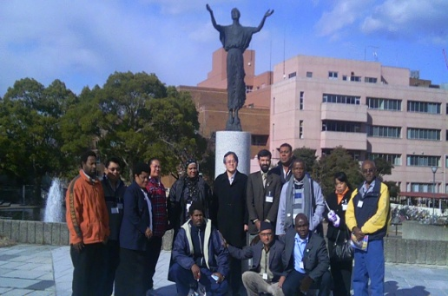
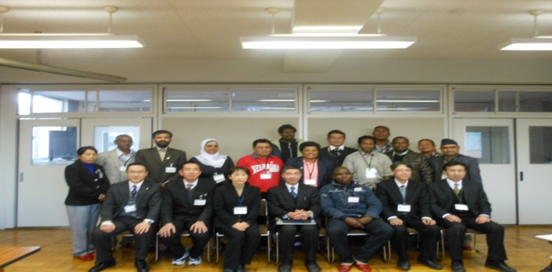
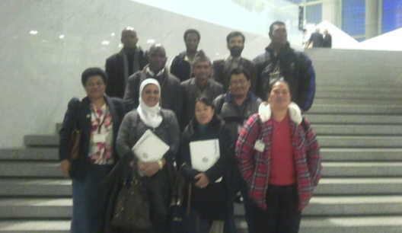
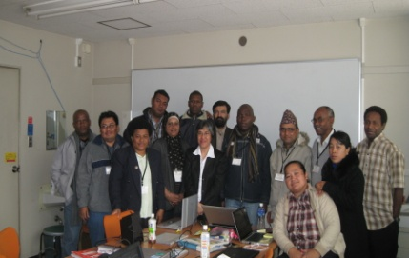
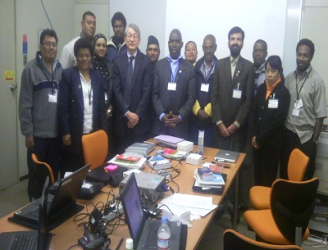
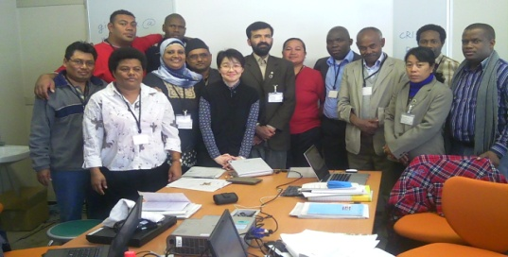
Arigato
Gozaimasu!

