Slide 1
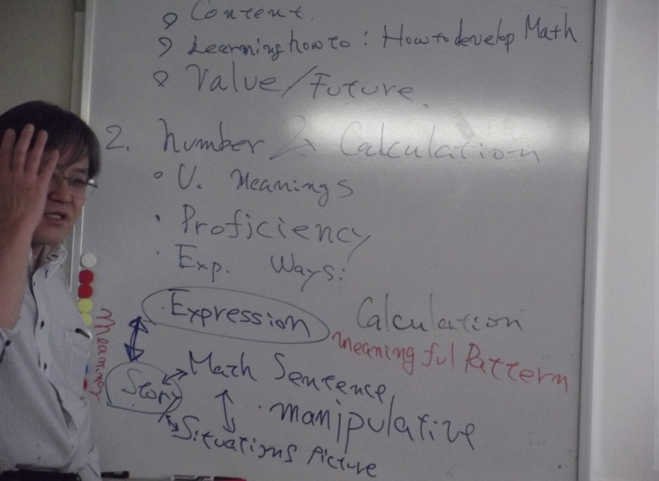
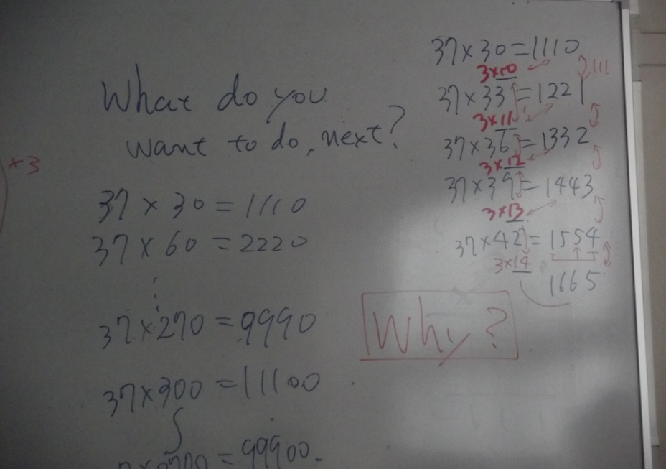
The J1 100711 Group training course on
“IMPROVING TEACHING METHODS IN MATHEMATICS IN PRIMARY EDUCATION
ACTION PLAN
Date :23th January -2nd March 2012
Name: Angele Jeffrey Country :Vanuatu
Organisation: Lingarak Primary School Position : Head Teacher

Slide 2
Title Multiplication:
Period: 6 months
Target Location:
Target Group: 5 (Five) teachers and 130 students
Narrative Summary
1. OVERALL GOAL
Children know the meaning ,how to construct and apply multiplication with good understanding

Slide 3
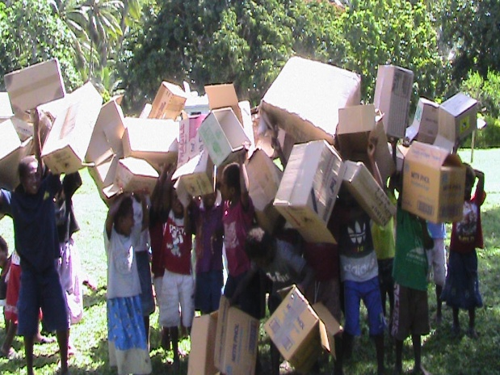
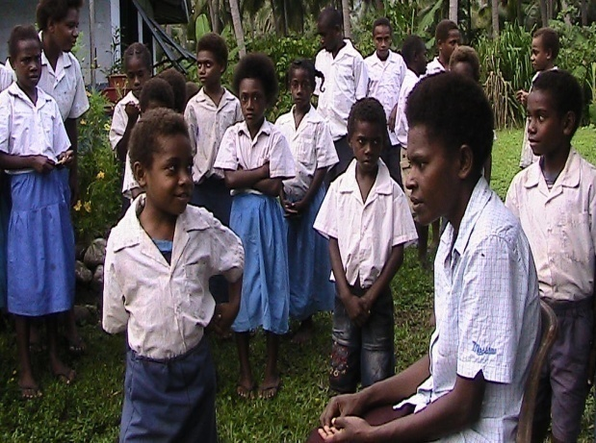
THE SPECIFIC OBJECTIVES
PROJECT PURPOSE
The appropriate curriculum sequence and method of teaching Multiplication at Lingarak Primary School is increasing
Current situation
1.Teachers teach multiplication without a good sequence
Multiplication were written on cards for children to learn . A teacher with students giving answers to times table
The school math team is trying to find ways to help the children develop their multiplication skills .

Slide 4
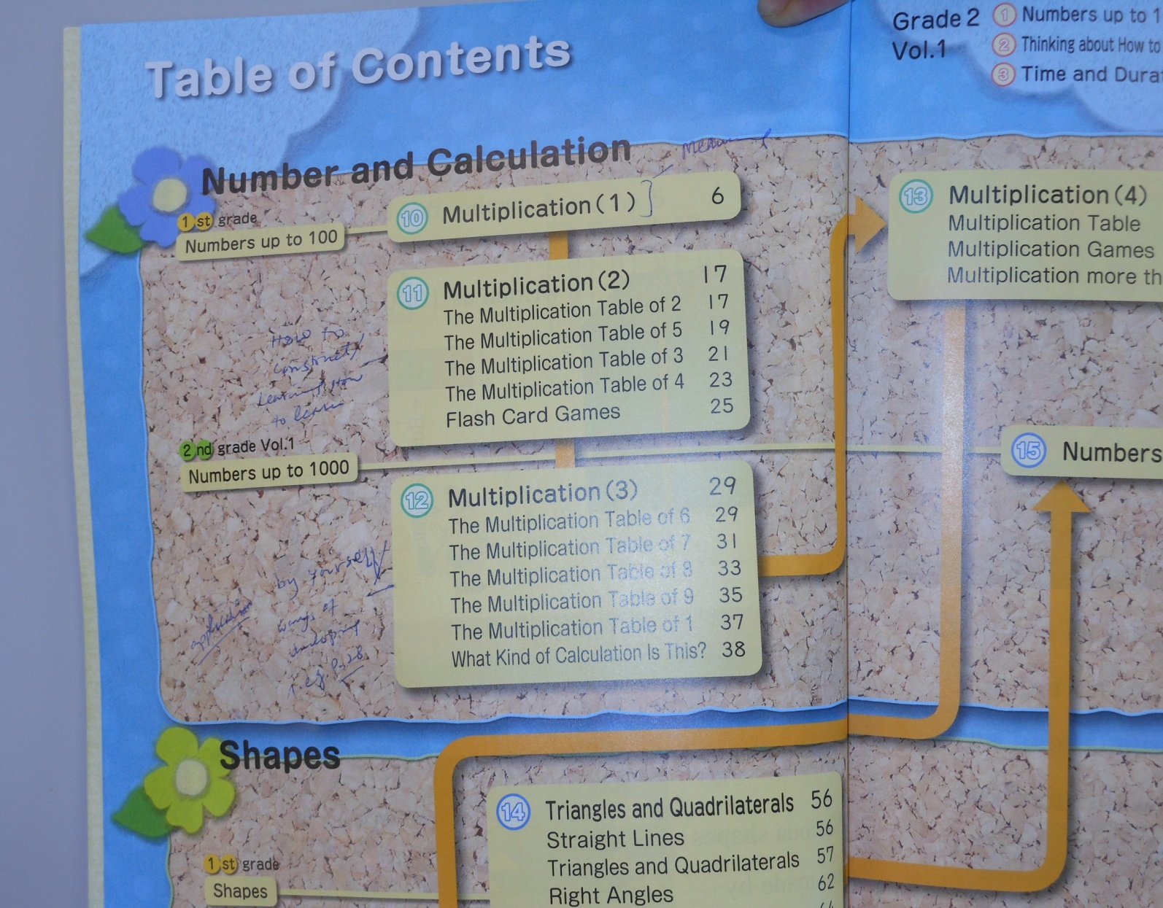
What I learnt in Japan
There are four chapters of Multiplication in the text books are arranged in a meaningful order
Why there are four units for multiplication?
Meaning
Math world
Learning how to learn
Application / Adaptation / learning by themselves

Slide 5
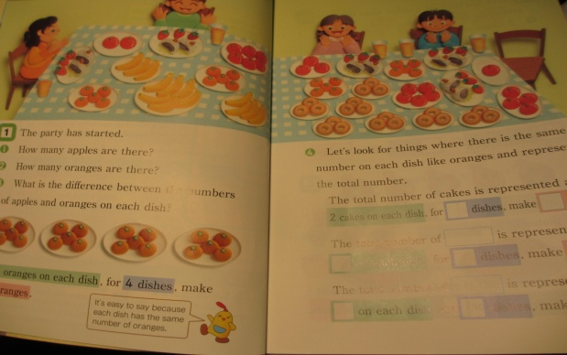
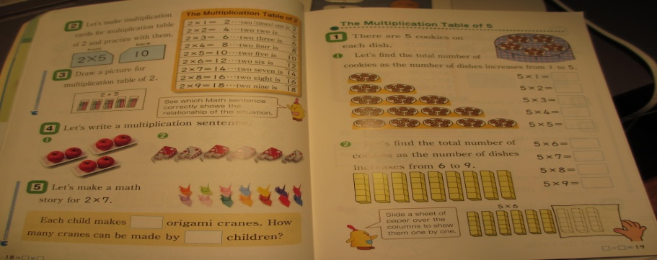
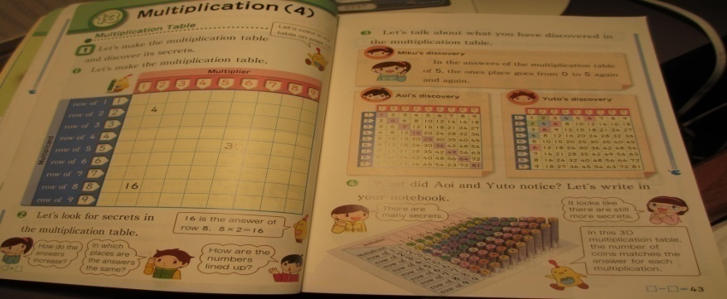
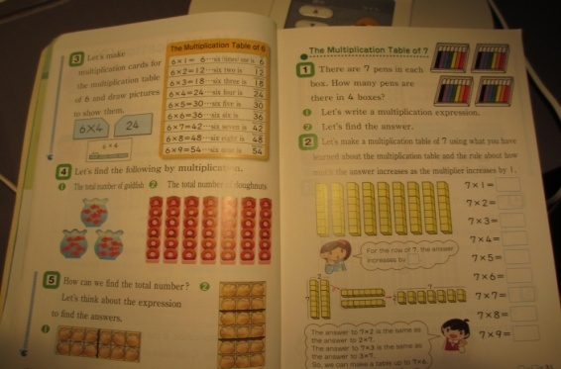

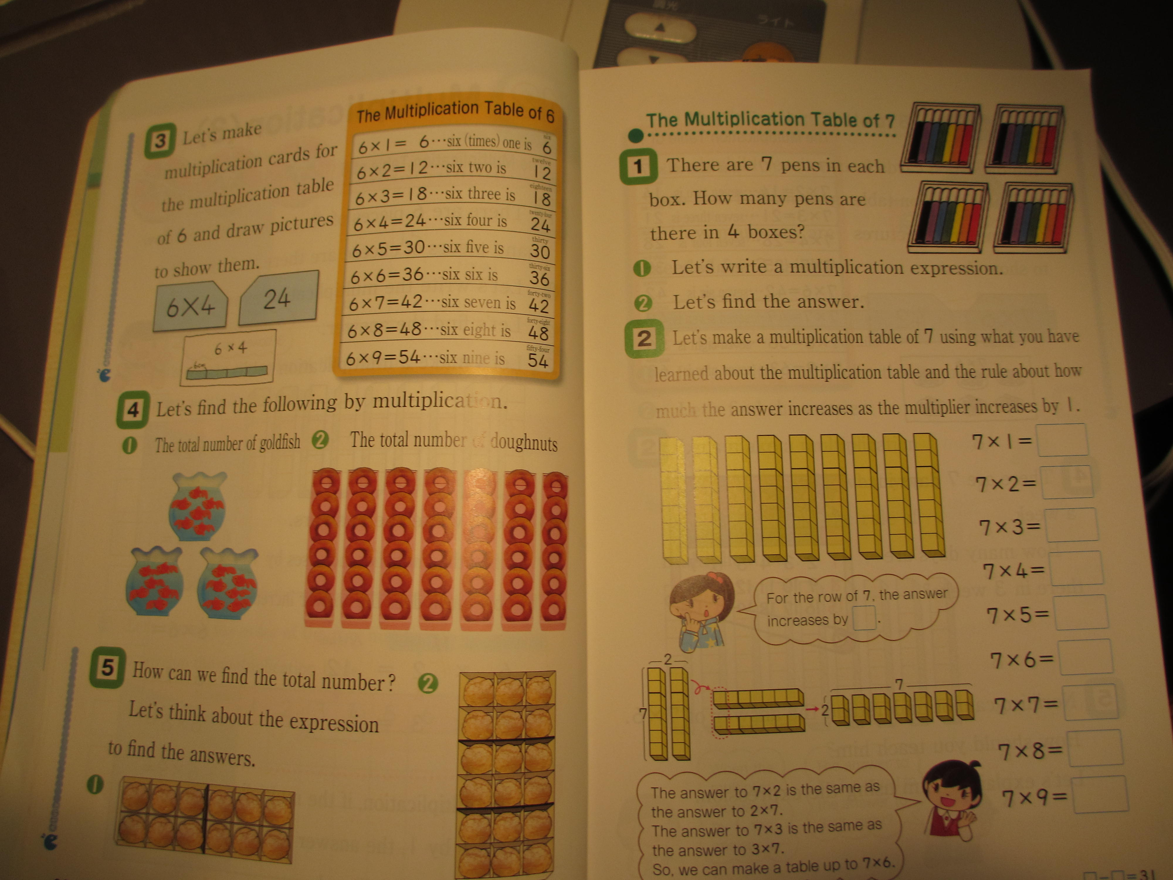
Chapter: 1 Meaning
Chapter:2 Learning how to learn
Children know the meaning of multiplication in the first chapter
The children learn how to learn by themselves after knowing the meaning of multiplication
Children can then apply the knowledge they gain from previous chapters
Now the children can enjoy the math world after mastering the basic concept of Multiplication
Chapter :3 Application/Adaption/Learning by themselves
Chapter :4 Math world

Slide 6
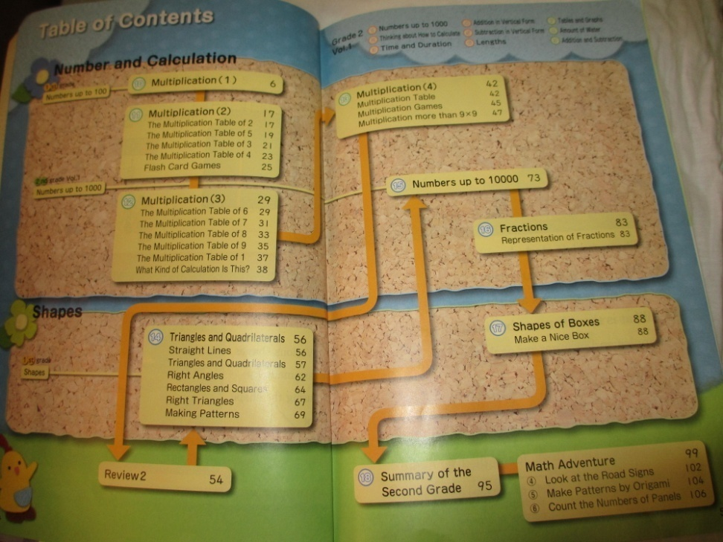
OUTPUTS--by applying your learning in
Japan. applying your learning in Japan
:
Output: 1
—Teachers gain good knowledge about appropriate curriculum sequence.

Slide 7
Output continue
Output:2
---A text book is arrange in a meaningful order for each class
Configuration of the Textbook
      Introduction
      . The textbook presents familiar topics to stimulate the pupils’ interest and concern.
Development
  The purpose of this component is for all pupils to refine their abilities.
Testing
  The textbook presents problems for teachers to check the pupils’ understanding

Slide 8
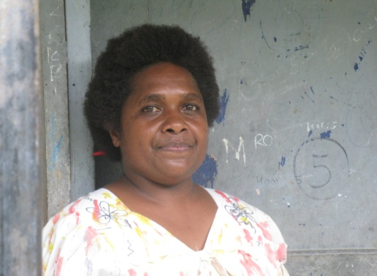
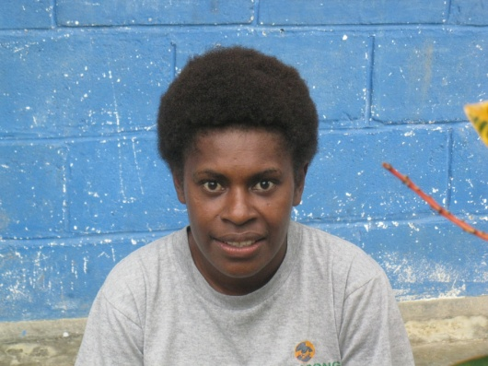
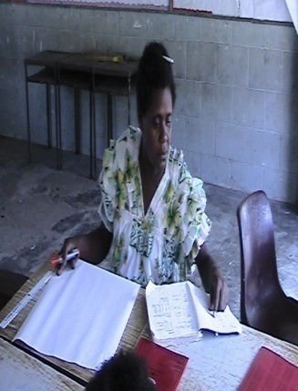

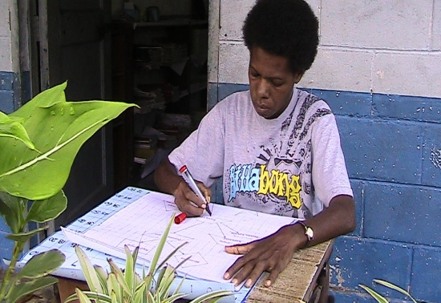
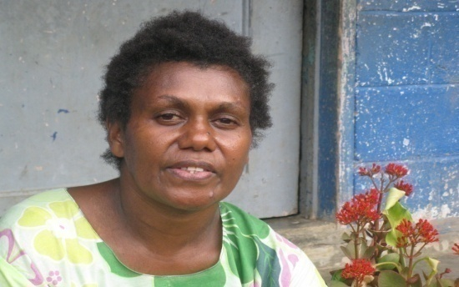
ACTIVITIES
Output:1-Teacher s gain good knowledge about the appropriate curriculum sequence
ACTIVITY—1.1
To conduct a workshop for the teachers to know about the multiplication chapters in the Japanese text book.

Slide 9
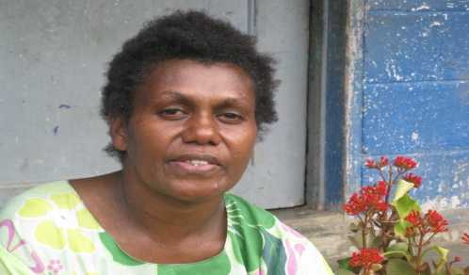

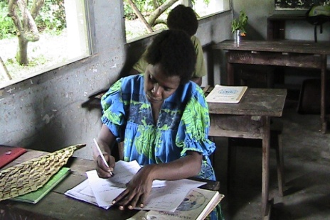
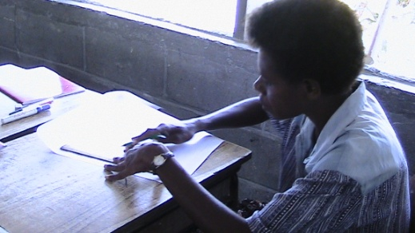
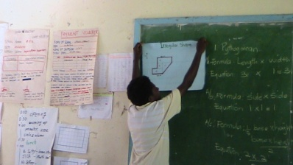
Activities continue
Output :2 A text book is arrange in a meaningful order for each class
Activity 2-1 To contact a workshop for the teachers to rearrange Multiplication chapters in a meaningful order(Make a plan of operation )
Children know the MEANING , how to COSTRUCT and APPLY MULTIPLICATION ???????

Slide 10
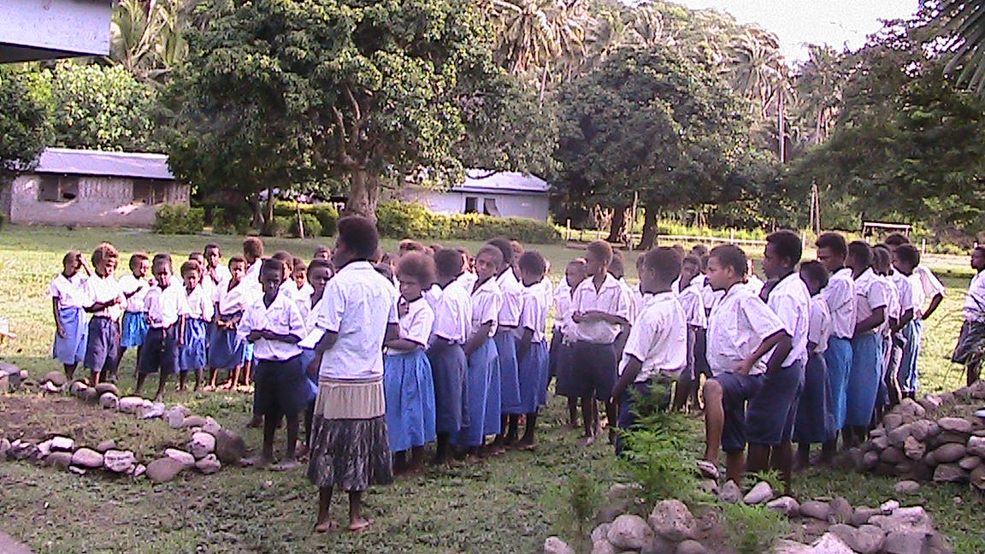
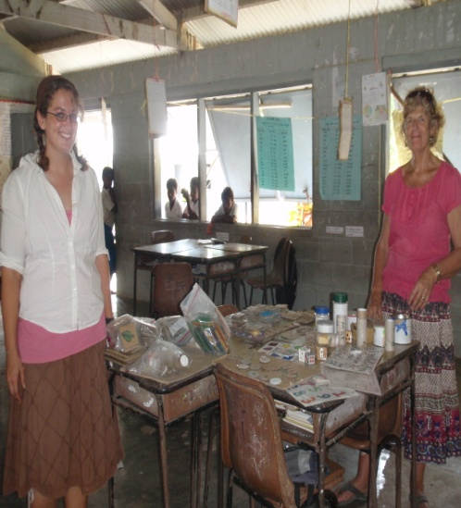
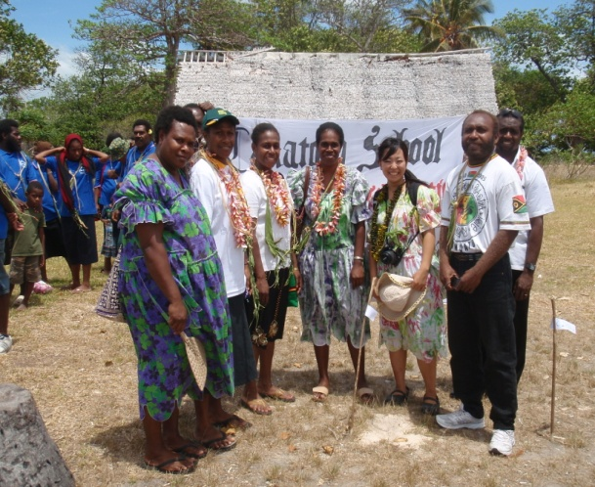
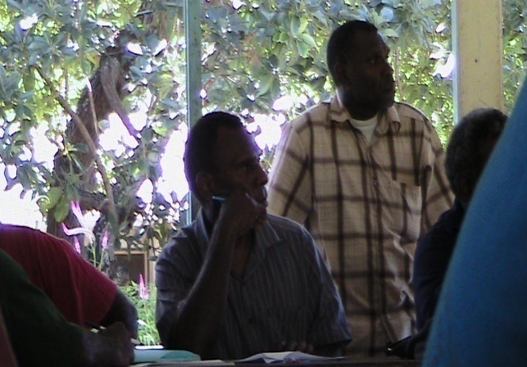
Activity continue
Activity 2-2 Conduct a workshop to confirm completion of text book and the discussion of the use and assessment according to planned programs.

Slide 11
Thankyou very much for listening

