Slide 1
Jica Training
Improving Teaching Methods in Mathematics in Primary Education.
Tevanu Davy
Lakatoro primary &secondary school
Republic of Vanuatu
2012

Slide 2
Overall Goal
students possess a good understanding on the signification of operation, subtraction, multiplication, and
division, then easily figure out their application in solving problems.

Slide 3
Specific Objective
students possess a good understanding on the signification of operation, subtraction, multiplication, and
division, then easily figure out their application in solving problems.

Slide 4
Your Learning in Japan
The chapters on multiplications and divisions are organized in the pupils’ textbooks sequentially which then help students developing their knowledge on those topics coherently.
2. ’Mathematics is an enjoyable subject for developing mathematical thinking which is necessary for all academic subjects and useful for the modern world.’(Isoda and Katagiri 2012: viii).to reach this stage one should prepare his/her lessons in advanced.

Slide 5
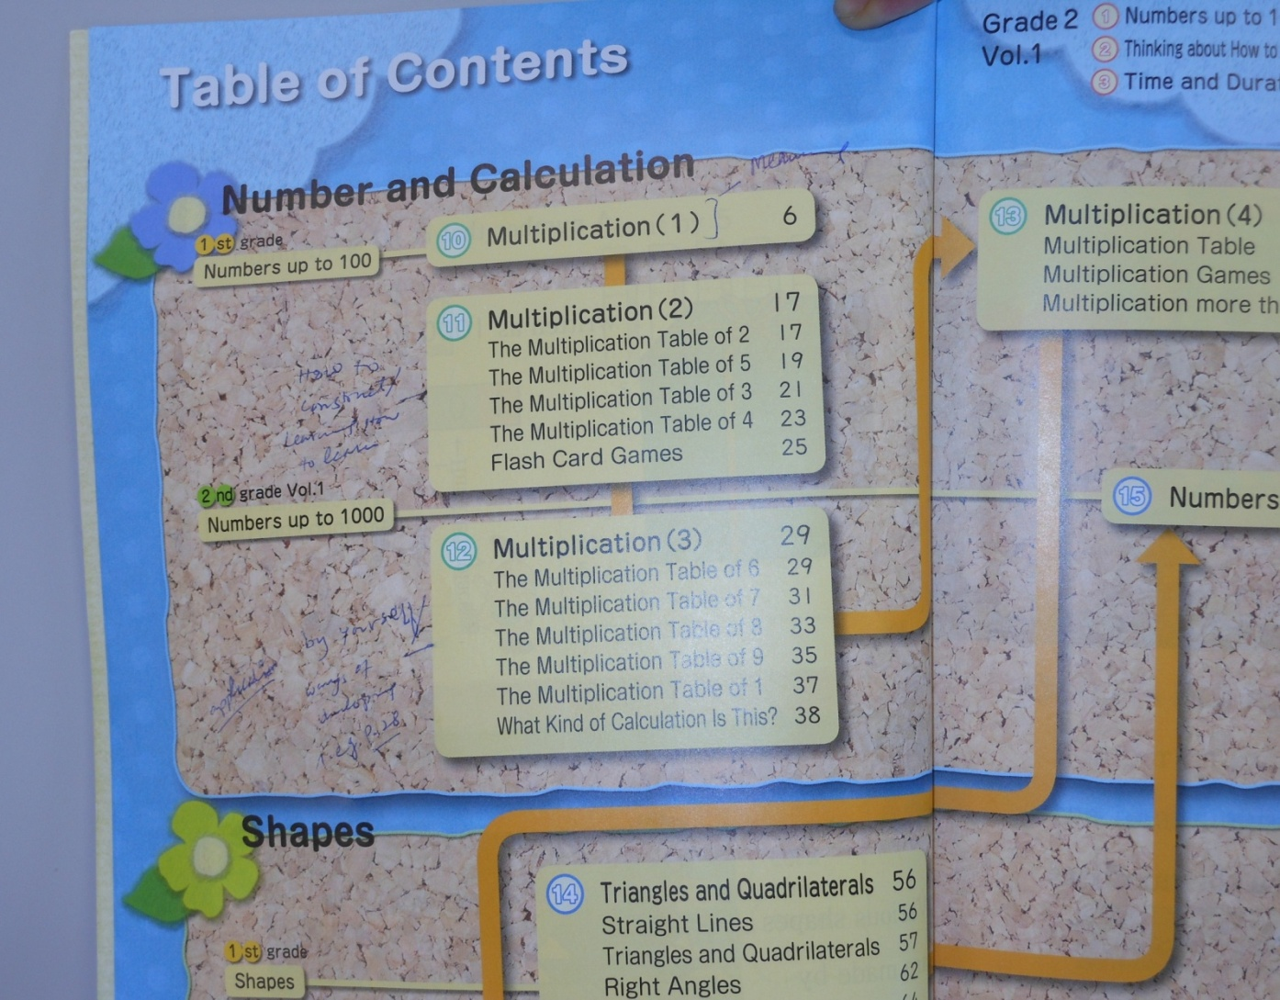
Multiplication
Japanese Pupils textbook Grade 2 Vol.1

Slide 6
Output 1
: students will possess and develop the ability to calculate easily operations involving addition, subtraction, multiplication, and division.

Slide 7
Activity 1
1-4 finally the tests will be corrected then analyzed to measure the improvement of the students

Slide 8
Output 2
through mathematics students will gain interest in school then perform well in their mathematics scores. Teacher prepare weekly, monthly and yearly lesson plans if possible.

Slide 9
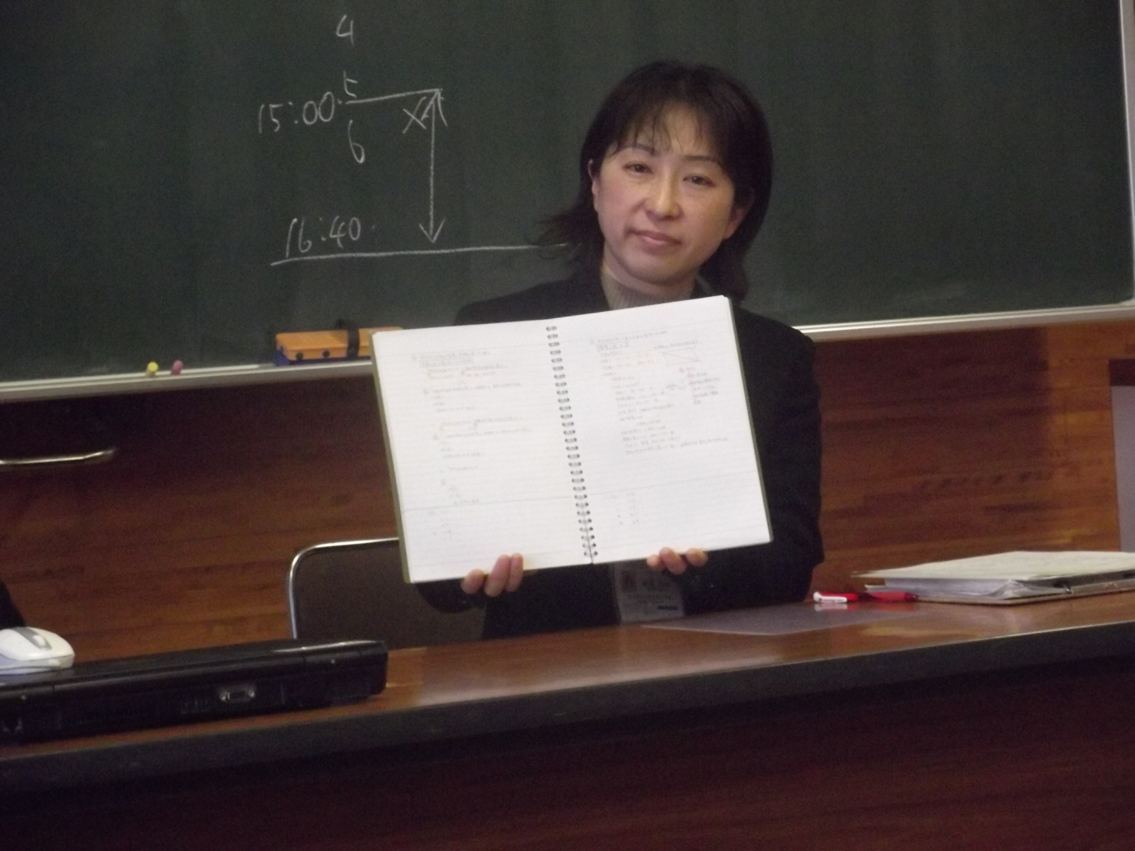
Kyoko Inaba Sensei in action with the content of her lesson plans in hands.(Teshirogi Junior high school)
Lesson plan

Slide 10
Activity 2
teacher prepare weekly and monthly lesson plans, yearly if possible.

Slide 11
Acknowledgment
I would like to thank the personnel of JICA organizing this training course.
Professor Masami Isoda
Our coordinator Yuhara Atsushi Sensei.
Kubota Miki Sensei.
And all individual and institutions who have been cooperating with JICA participants to make this training program successfully achieved its goal.

