Slide 1


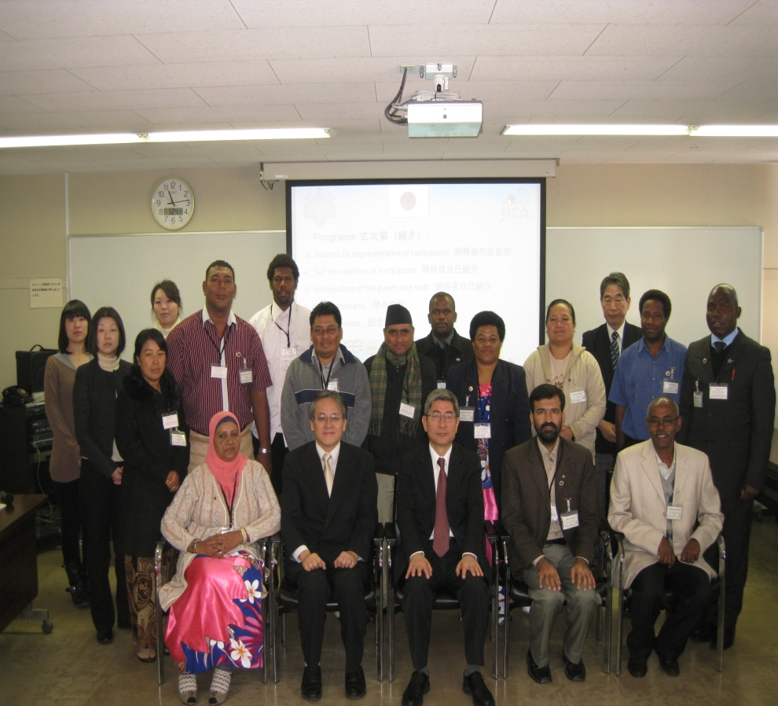
Action Plan
The J1100711 Group Training Course on
“IMPROVING TEACHING METHODS IN MATHEMATICS IN PRIMARY EDUCATION”

Slide 2
Name : Tuamelie Mahe
Country : Kingdom of Tonga
Organization : Ministry of Education, Women, Affairs &Cultures.
Position : Senior Assistant Teacher (SAT)
Title : To improve SEE Mathematic Result.
Period : ６ Months
Target Location: All Eua Government Primary School
Target Group : Class 6 students(Mathematics Result on SEE)

Slide 3
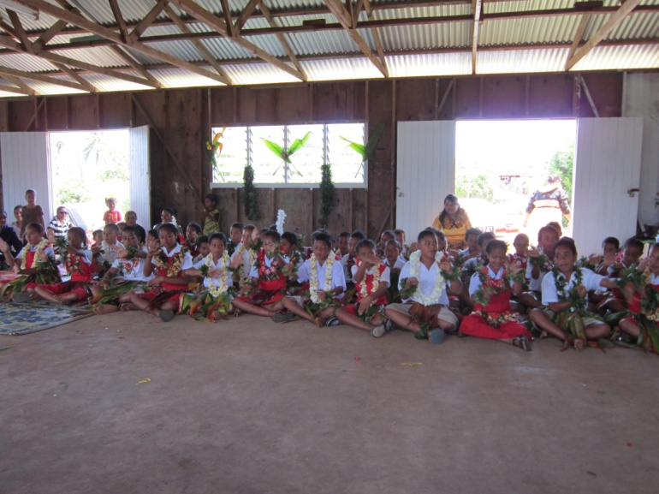
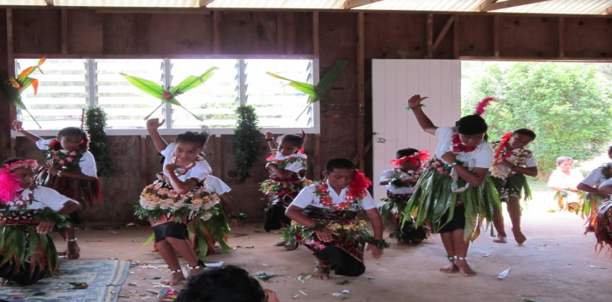
NARRATIVE SUMMARY
OVERALL GOAL
SPECIFIC OBJECTIVES (PROJECT PURPOSE)
Class 6 SEE result on my island is improved.
Class 6 students show improvement in number concept area and words solving problem.

Slide 4
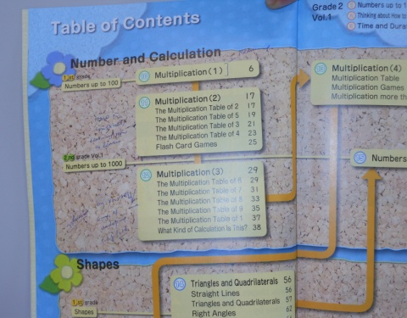
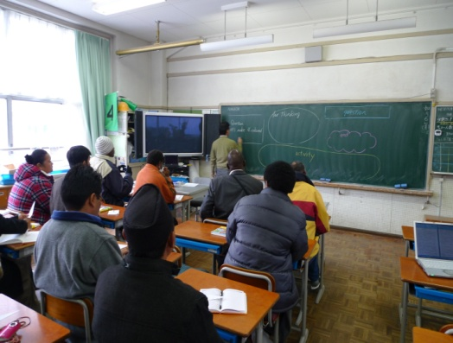
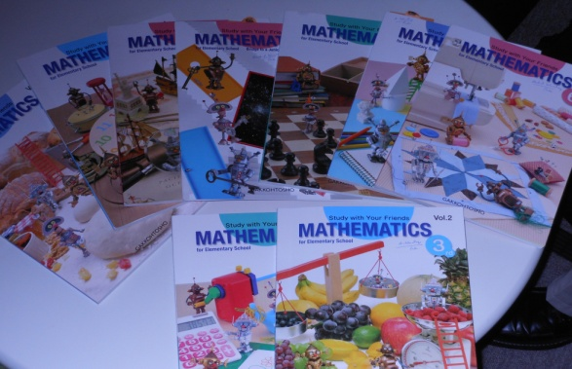
LEARNING IN JAPAN
I learn how to do textbook analysis.
I learn about the solving problem approach.
I learn how to write on the blackboard.
I learn about the lesson study.
I learn about PDM &AP.
I learn about the curriculum here in Japan.
I learn about the system, content and teaching method here in Japan.
I learn about how to prepare a lesson plan.

Slide 5
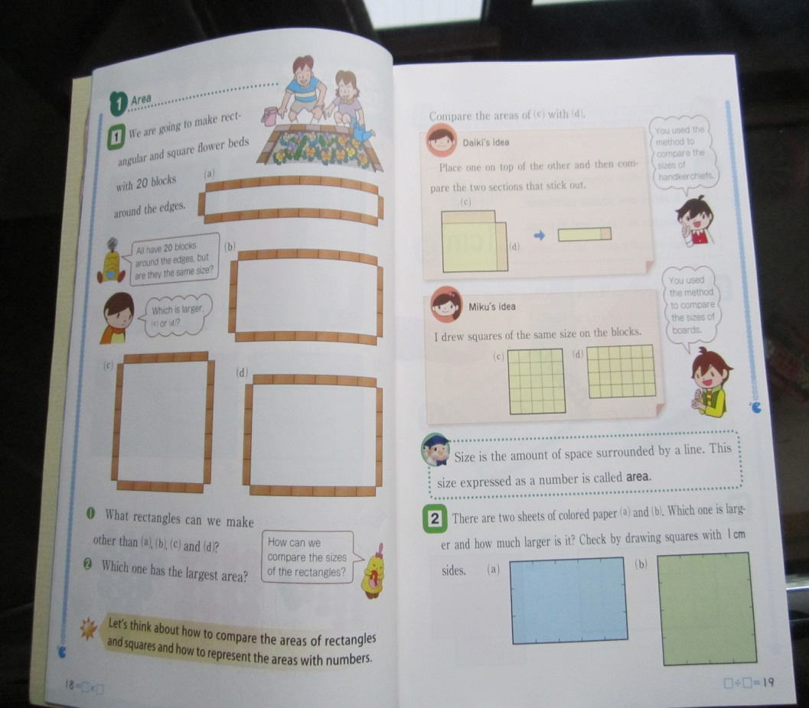
Problem Solving Approach
Problem Solving
Understand a given problem.
Plan an approach and process to solve.
Think in logic (think by themselves).
Explain one’s idea and listen other’s (Group discussion)
Summarize contents
Practice
Task
Many ways
Compare and Select Solutions for developing appropriate ideas
Problem

Slide 6
OUTPUTS : by applying your learning in Japan
Output 1
Workshop training for class 6 mathematics teacher is run well and effectively
Output 2
Suggestion is made to the MOE and SBM to improve the situation of students and teacher ratio and the lack of resources in school.
Output 3
Improvement in communication between teachers and parents.

Slide 7
ACTIVITIES
Output 1
Activity 1-1 – Preparation of workshop training with district education officer and his assistant .
Activity 1-2.- Preparing workshop schedule base on what I learn from Japan on this course.
Activity 1-3.- Conducting workshop twice a month on the first and the second Friday starting on April to July.
Activity 1-4.- Practice lesson study on August and September, two groups in August(last Friday )and two groups in September(last Friday).

Slide 8
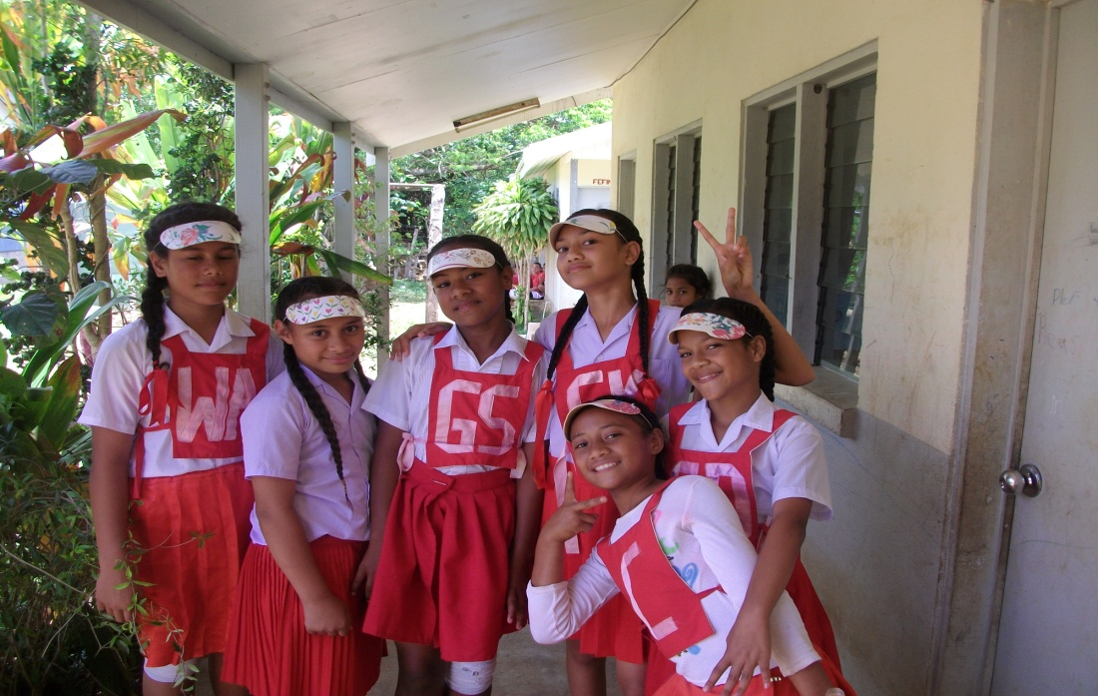
Output 2
- Activity 2-1 - Calls for meeting among principals of each school to discuss the schools problems and to make a suggestion together to MOE and SBM.
- Activity 2-2 – Organizing a meeting with the district education officer to discuss the transportation problem.

Slide 9
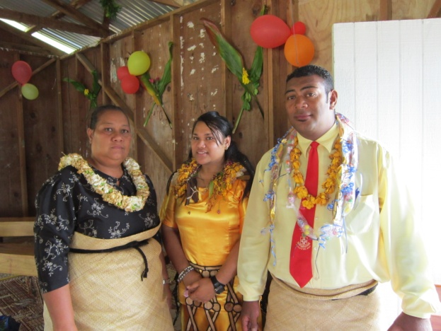
Output 3
- Activity 3-1 – Principals of each schools call for a PTA meeting to discuss about the important of education and problem of children who run away from school.
- Activity 3-2 – Teachers and parents organize a collaborative activity to deal with children who run away from schools.
- Activity 3-３ – Class 6 teachers organize extraｃlasses for preparing SEE in schools and parents assist the attendance of children to extra classes.

Slide 10
Plan of operation
Output No. | Output No. | Expected results | Time Schedule(Months of Year) 1 2 3 4 5 6 7 8 9 10 11 12 |  |  |  |  |  |  |  |  |  |  |  | Persons in charge | Implementers | Materials, equipments | Budget | Remarks
1 | Activity1.1-Preparation of workshop training with district education officer and his assistant . Activity 1-2.- Preparing workshop schedule base on what I learn from Japan on this course. Activity 1-3.- Conducting workshop twice a month on the first and the second Friday starting on April to July. Activity 1-4.- Practice lesson study on August and September, two groups in August(last Friday )and two groups in September(last Friday). | ・They will agree both of the Education Officer to conduct a in-service training. ・Teachers will happy to participate in the workshop and they will learn new teaching skills and new ideas. ・Lesson study will implement and we will learn from each other’s throughout the year. |  |  |  |  |  |  |  |  |  |  |  |  | Setikia.Vea. (Education officer | Vaita Kavaliku Tuamelie Mahe. | A4 Paper/pens. Textbook/chalk /board | $3000

Slide 11
Output No. | Activities | Expected results | Time Schedule(Months of Year) 1 2 3 4 5 6 7 8 9 10 11 12 |  |  |  |  |  |  |  |  |  |  |  | Persons in charge | Implementers | Materials, equipments | Budget | Remarks
2 | - Activity 2-1 - Calls for meeting among principals of each school to discuss the schools problems and to make a suggestion together to MOE and SBM. - Activity 2-2 – Organizing a meeting with the district education officer to discuss the transportation problem.. |  |  |  |  |  |  |  |  |  |  |  |  |  | Setikia Vea. | Setikia Vea. Principals. | Papers &Pens Phone Card

Slide 12
Output No. | Activities | Expected results | Time Schedule(Months of Year) 1 2 3 4 5 6 7 8 9 10 11 12 |  |  |  |  |  |  |  |  |  |  |  | Persons in charge | Implementers | Materials, equipments | Budget | Remarks
3. | - Activity 3-1 – Principals of each schools call for a PTA meeting to discuss about the important of education and problem of children who run away from school. - Activity 3-2 – Teachers and parents organize a collaborative activity to deal with children who run away from schools. - Activity 3-2 – Class 6 teachers organize extraｃlasses for preparing SEE in schools and parents assist the attendance of children to extra classes. |  |  |  |  |  |  |  |  |  |  |  |  |  | Principal Speakers of the PTA | PTA member Class 6 teacher | BOOKS &PENS | $100

Slide 13
Thank You!
MALO AUPITO

