Slide 1


Improving Teaching Methods of mathematics in Primary Education (JFY 2011)
Action Plan
For
Lesotho College of Education
by
Maboi Zacharia Mphunyane

Slide 2


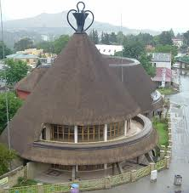
Overall Goal
Objective
Students who are registered for mathematics courses in Lesotho College of Education improve their academic achievement
Students who are registered for mathematics courses in Lesotho College of Education show positive attitudes towards mathematics and their learning

Slide 3
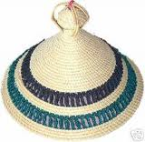
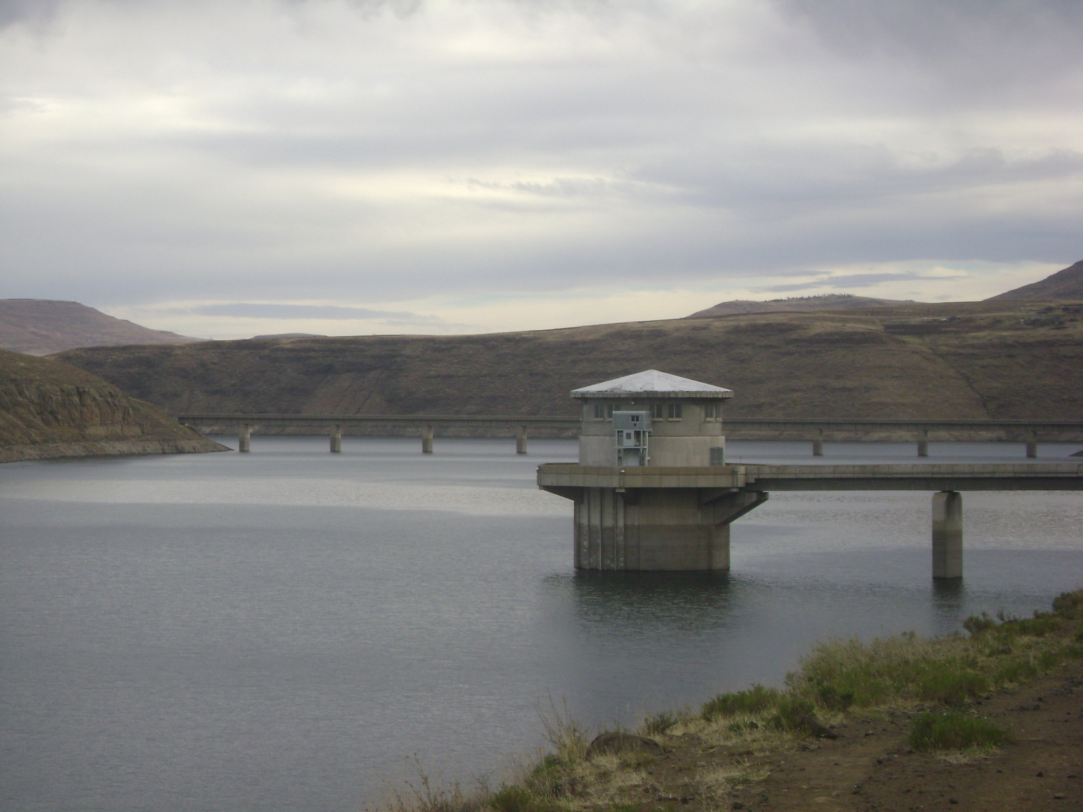
Title of the Project
Establishing structures that will allow use of problem solving approach in mathematics classrooms at Lesotho College of Education.

Slide 4

Background Problems
Large teacher trainer : student ratio
Shortage of useful resources like computers
Use of traditional approach to teaching, i.e. telling
Etc

Slide 5
What has been learnt in Japan?
1
Problem solving approach to teaching: posing: the lesson
Teaching materials:
- provide situation from which a problem ca be posed for
learners learn by-/for themselves
Textbooks:
- aligned to flow of normal classroom lesson
Chalkboard writing is done to ensure all important points remain on the board until the end of the lesson.

Slide 6
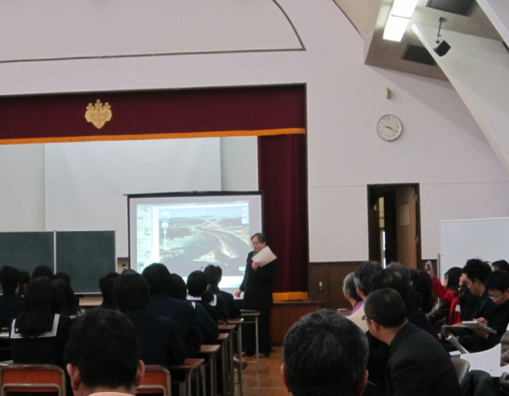
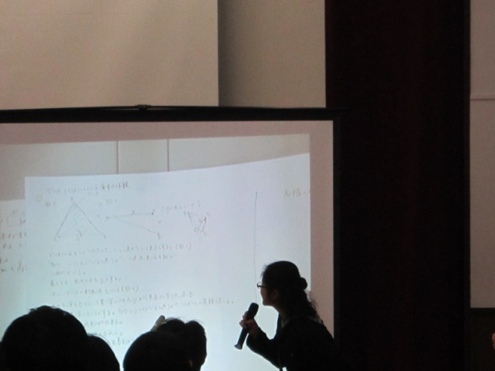
Lesson Study
Lesson Study: (Plan, teach, observe, reflect, revise)
Lesson study session; and problem posing at Junior High School, Otsuka. (Isoda-sensei’s class)
Establish lesson study group in the department

Slide 7
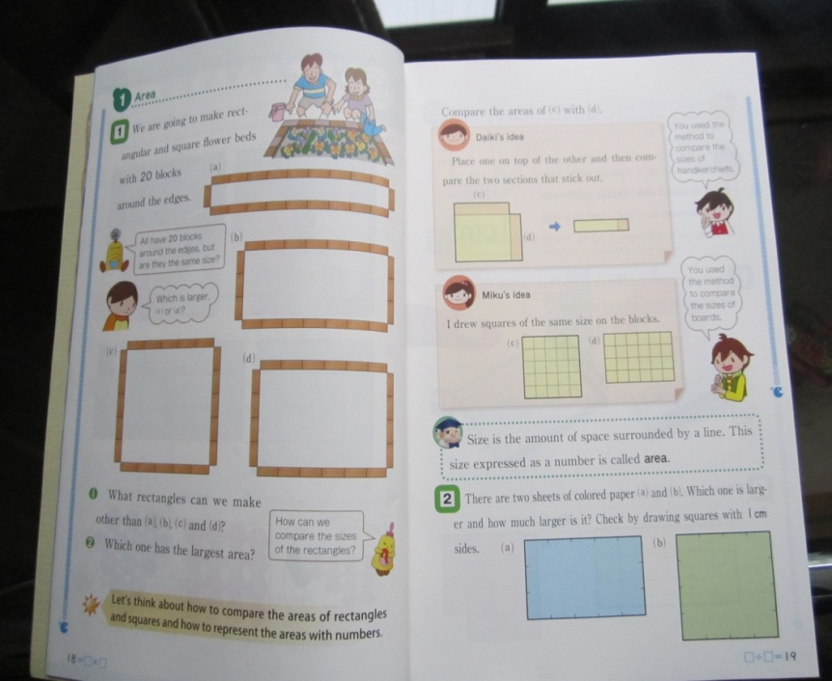
Objective
Teaching Methods
Problem based/problem solving approach;
enhanced through lesson study
Establish lesson study group to problem based approach to teaching

Slide 8
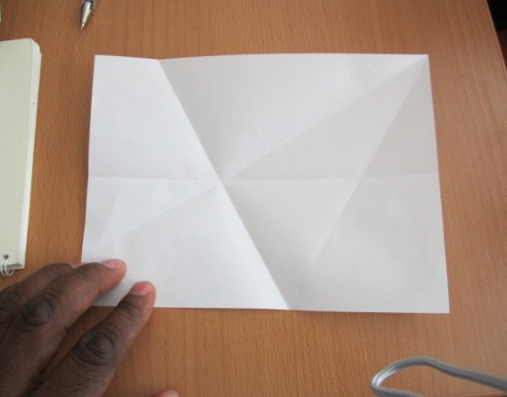
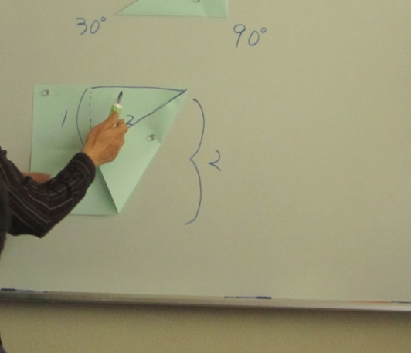
Paper Folding
-Origami- by Professor Haga
Paper-folding to make some shapes to use in other topics, e.g. Symmetry.
Students make these materials in their projects

Slide 9
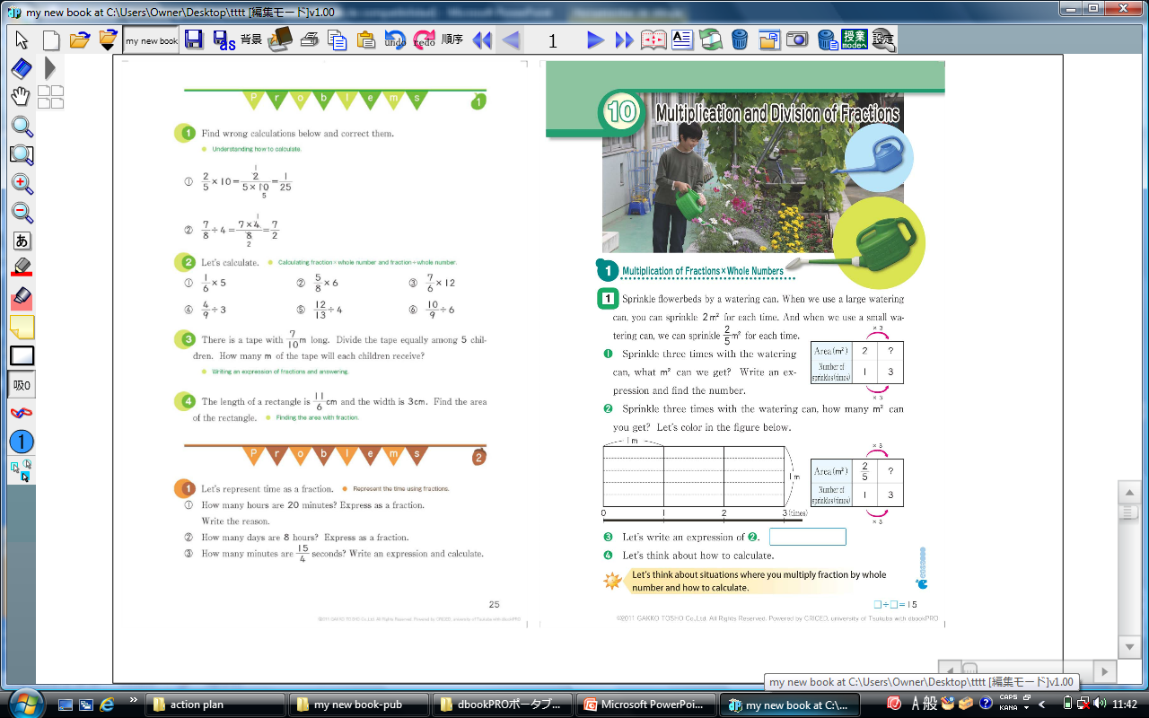
D-book software used to make this digital book
Prepare digital books

Slide 10
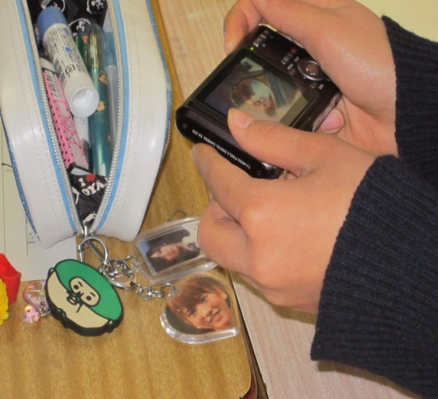
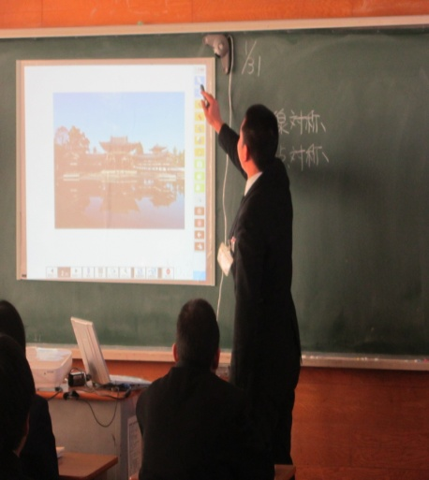
Integration of computer skills training in mathematics
-e-board, etc-
Plan to integrate training of use og electronic equipment such as computers and mobile phones for mathematics
Makinadan-sense using interactive board to teach symmetry.

Slide 11
End of Slide Show
Thank You
Arigatogozaimasu

