Slide 1

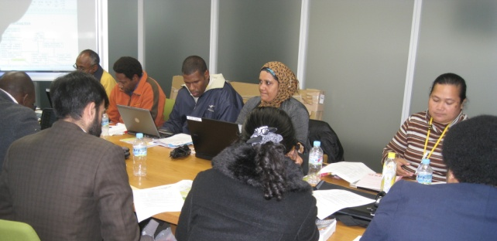
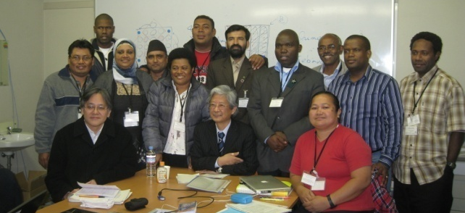
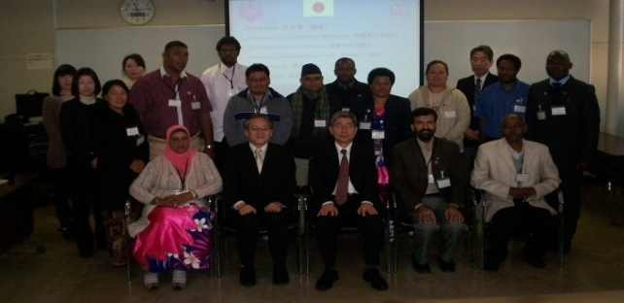
2012 Action plan
Melanie N. Yangrelbug

Slide 2
Content
Objective Tree
Narrative Summary
Outputs and Activities
6 Months Activities
Indicators
When I go back…

Slide 3
Objective tree
Students master math skills and concepts.
Teachers use student-centered teaching approach.
Teacher training of student-centered teaching approaches are provided.
Ends
Core Objective
Purpose
Means
Outcome

Slide 4
Summary
Overall Goal | Students master and maintain their grade level math skills and concepts.
Project Purpose | Teachers of Grades 1 to 3 will be able to use open-ended teaching approach.
Learning from this Japan Math Training | 1. Problem solving approach 2. 3 Thinking Skills: deductive, inductive, and analogical thinking 3. Blackboard Management 4. Japan Textbook Format 5. Japan Teacher Training Programs 6. Lesson Study
Output 1 | Teachers are able to implement open-ended teaching approach in their class.
Output 2 | Teachers are able to implement open-ended approach in a lesson-study or open class.

Slide 5
Output 1 Activities
Implementation of open-ended approach
Activity 1-1
Provide Teacher Training on Open-Ended Teaching Strategies 3 times a year
Activity 1-2
Provide Teacher Training on Classroom Management
Activity 1-3
Provide Teacher Training on Blackboard Management

Slide 6
Output 2 activities
Open-ended approach in lesson study and open class.
Activity 2-1
Teachers use open-ended approach in lesson study and open class
  Guide and assist teacher in lesson plan
  Set up dates for the implementation of open-ended approach lesson in lesson study
  Set up a date for implementation of open-ended approach in open class
  Monthly Monitoring and Conference
  Lesson Study implementation
  Open Class implementation

Slide 7
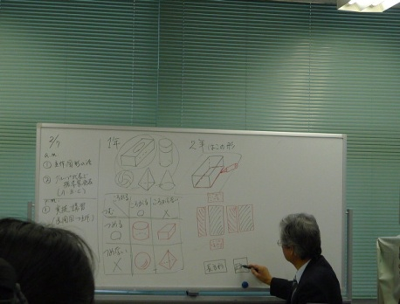
6 months activities 2012
(june to August)
June
Meeting with School principal and teachers regarding the piloting of open-ended approach.
July
Open-ended approach training
August
Meeting with pilot school
Monthly monitoring and conference
Classroom Management Training
Blackboard Management Training
Student Evaluation
Teacher Evaluation

Slide 8
6 months activities 2012
(September to november
September
Monthly monitoring of pilot school and conference
October
Open-ended approach training
Classroom management training
November
Monthly monitoring of pilot school and conference
Student evaluation and analysis
Blackboard management training
Monthly monitoring of pilot school and conference
Teacher Evaluation and analysis

Slide 9
Indicators of project within 6 months
The overall student average grade in the Short Assessment of Mathematics (SAM) will be above 65%.
The overall student average grade in the Math Quarterly Assessment will be above 65%.
Teachers will get at least 4.5 average points in their class observation evaluation at the end of 6 months of implementation (November 2012).

Slide 10
As soon as I go to palau tasks
Share plan with my supervisor, Chief of Teacher Training Orrukem, and my teacher training colleagues Sarah and Linda
Get the approval of Director of Bureau of Curriculum and Instruction Sbal
Share my report with principals in the Principal Quarterly Forum to get the names of schools that can pilot the project
GOAL: Students will master math skills and concepts by/for themselves.

Slide 11
Thank You So Much for
Not Blinking Throughout My Presentation.

