Slide 1
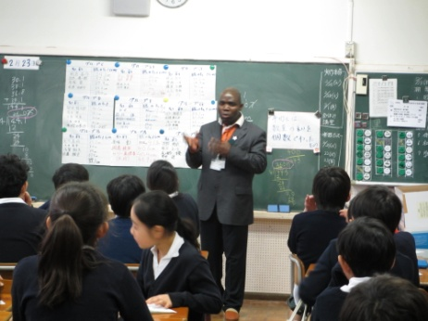

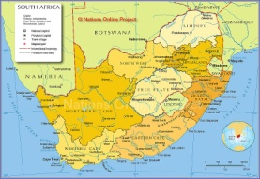

ACTION PLAN
Country:South Africa
Name: Paul Mukwena
IMPROVING TEACHING METHODS IN MATHEMATICS IN PRIMARY EDUCATION”
ORGANIZATION :NORWOOD PRIMARY SCHOOL
POSITION: HEAD OF DEPARTMENT FOR MATHEMATICS AND NATURAL SCIENCES

Slide 2
Title : | Mathematics Improvement
Period: | 6 Months
Target Location: | Norwood Primary School
Target Group: | Students/Teachers
NARRATIVE SUMMARY

Slide 3
WHAT I LEARNED IN JAPAN
Japanese Education system
Schooling system in Japan:
Nursery, Elementary, Junior High School, Senior High School and University/College
Curriculum: Mathematic Aims
willingly make use of mathematics in their daily lives as well as in their learning, to help pupils find pleasure in mathematical activities and appreciate the value of mathematical approaches
Curriculum: Overall Objectives:
to foster their ability to think and represent everyday life ,w with good perspective and logically on matters of

Slide 4

Continued…
Curriculum Integration : Integrating natural disastrous such as Tsunami and Earth Quake in mathematics
Teacher Training System: how teachers are trained, how to acquire teaching license and the roles that are played by prefectures
Lesson Study : process and the flow of lesson study
System of Assessment
Textbook Configuration
Sequence of Mathematics Textbooks : through manipulation learners understand and develop their own idea of calculation (Situation-Mathematical world- Expression ) or reversal of this process

Slide 5
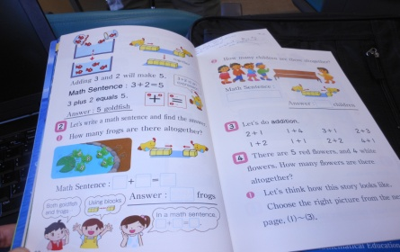
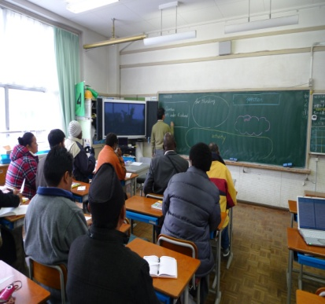
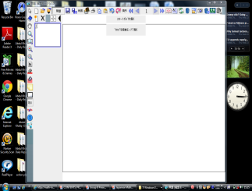
    Japanese Mathematics Method Content for Elementary School
School Education in Japan
Elementary Mathematics Curriculum Objectives
Sequence of Mathematics Textbooks : through manipulation learners understand and develop their own idea of calculation (Situation-Mathematical world- Expression ) or reversal of this process
Blackboard Writing in Mathematics Lessons and how productive it is when used correctly, it reflects evidence of what have been learnt in the classroom, the ideas of learners are shown in the blackboard
Questioning/ ‘Hatsumon’: This forms a very important of learning: Planned prior to class but can change through students’ ideas impact of hatsumon is usually discussed during post lesson discussion, “Isoda” What next?
d-book Software and Digital Textbooks
Statistical Literacy Examples from PISA

Slide 6
Output 1
The understanding of teaching mathematics outcomes, assessment standards and mathematics content is improved by all educators
on Output 1
Activity: 1
Good quality of moderated mathematics worksheets
  to prepare mathematics worksheets for all the grades
  to develop a student activity work book
to conduct training on how to prepare a quality worksheet
  to monitor and support educators in their planning
  Maintain the standard of students who get high marks
  Introduce lesson study as a way of improving learning and teaching at school

Slide 7
Output 2
The attendance of mathematics extra classes by students is very good
Activities
-1 to select students who can attend extra classes
2-2 Identify teachers who can offer mathematics extra classes
2-3 develop special worksheets for students who attend mathematics extra classes
2-4 support students who attend extra classes
2-5 graduate students who have shown great improvement in mathematics to
the expert group of students
2-6 Involve parents in supporting the students who attend extra classes
2-7 To support teachers in their attempt to improve mathematics achievement
2-8 To award students who do well in mathematics

Slide 8
Output 3
The work schedule which shows the guidelines of teaching mathematics and topics to be covered is followed appropriately by all mathematics teachers
Activities
3.1 Develop a system of ensuring that mathematics content is covered
3-2 to review current challenges on covering the mathematics content
3-3 develop a model of communicating to the parents about how to support their children at home

Slide 9
Output | Activities | Expected results | Time Schedule/Frame In Months |  |  |  |  |  | Persons in charge | Implementers | Resources/ Material | Budget | Remarks
 |  |  | 1 | 2 | 3 | 4 | 5 | 6
Output 1 The understanding of teaching mathematics basic operation and contents is improved for all the grades at school | Good quality of moderated mathematics worksheets 1.To prepare mathematics worksheets for all the grades 2. To develop a student activity book 3.To conduct training on how to prepare a quality study material. 3.To monitor and support educators in their planning 4. Maintain the standard of students who get high narks 6. Introduce lesson study as a way of improving learning and teaching at school | Teachers to use effective methods of teaching and begin to understand the national curriculum Education of South Africa. Improve the preparation of lesson. Effective use of the textbook. Workshop on how to use teaching aids and Origami |  |  |  |  |  |  | Mr. Mukwena | Mathematic teachers Grade 1-7 Ms. Dube Mrs. Frank Ms. Mkhonto Mr. Sadiki Ms. Maelane Mrs. Motshegwa Mr. Mukwena | Blackboard, Whiteboard, Overhead projector, Charts, Colored chalks. Mathematics Policy document | R10,000 | Achieved/Not achieved
Operation Plan
Output | Activities | Expected results | Time Schedule/Frame In Months |  |  |  |  |  | Persons in charge | Implementers
 |  |  | 1 | 2 | 3 | 4 | 5 | 6
Output 1 The understanding of teaching mathematics basic operation and contents is improved for all the grades at school | Good quality of moderated mathematics worksheets to prepare mathematics worksheets for all the grades to develop a student activity book to conduct training on how to prepare a quality study material. to monitor and support educators in their planning Maintain the standard of students who get high narks 1-6 Introduce lesson study as a way of improving learning and teaching at school | Teachers to use effective methods of teaching and begin to understand the national curriculum Education of South Africa. Improve the preparation of lesson. Effective use of the textbook. Workshop on how to use teaching aids and Origami |  |  |  |  |  |  | Mr. Mukwena | Mathematic teachers Grade 1-7 Ms. Dube Mrs. Frank Ms. Mkhonto Mr. Sadiki Ms. Maelane Mrs. Motshegwa Mr. Mukwena
2 The attendance of mathematics extra classes by students is very good | 1 to select students who can attend extra classes 2-2 Identify teachers who can offer mathematics extra classes 2-3 develop special worksheets for students who attend mathematics extra classes 2-4 support students who attend extra classes 2-5 graduate students who have shown great improvement in mathematics to the expert group of students 2-6 Involve parents in supporting the students who attend extra classes 2-7 To support teachers in their attempt to improve mathematics method of teaching 2-8 To award students who do well in mathematics | Give learners opportunity to perform best according to their ability. To cultivate the love, Value and appreciation of Mathematics. |  |  |  |  |  |  | Mrs. Motshegwa | Mathematic teachers Grade 1-7 Ms. Dube Mrs. Frank Ms. Mkhonto Mr. Sadiki Ms. Maelane Mrs. Motshegwa Mr. Mukwena

Slide 10
2 The attendance of mathematics extra classes by students is very good | 1 to select students who can attend extra classes 2-2 Identify teachers who can offer mathematics extra classes 2-3 develop special worksheets for students who attend mathematics extra classes 2-4 support students who attend extra classes 2-5 graduate students who have shown great improvement in mathematics to the expert group of students 2-6 Involve parents in supporting the students who attend extra classes 2-7 To support teachers in their attempt to improve mathematics method of teaching 2-8 To award students who do well in mathematics | Give learners opportunity to perform best according to their ability. To cultivate the love, Value and appreciation of Mathematics. |  |  |  |  |  |  | Mrs. Motshegwa | Mathematic teachers Grade 1-7 Ms. Dube Mrs. Frank Ms. Mkhonto Mr. Sadiki Ms. Maelane Mrs. Motshegwa Mr. Mukwena | Record sheets | - | Achieved/Not achieved
3. The work schedule which shows the guideline of teaching mathematics and topics to be covered is followed appropriately by all mathematics teachers | .1 Develop a system of ensuring that mathematics content is covered 3-2 to review current challenges on covering the mathematics content 3-3 develop a model of communicating to the parents about how to support their children at home | Improvement in teaching all the concepts of Mathematics from the foundation phase |  |  |  |  |  |  | Mr. Mukwena and Mrs. Motshegwa | Mathematic teachers Grade 1-7 Ms. Dube Mrs. Frank Ms. Mkhonto Mr. Sadiki Ms. Maelane Mrs. Motshegwa Mr. Mukwena | -Policy document | - | Achieved/Not achieved

Slide 11
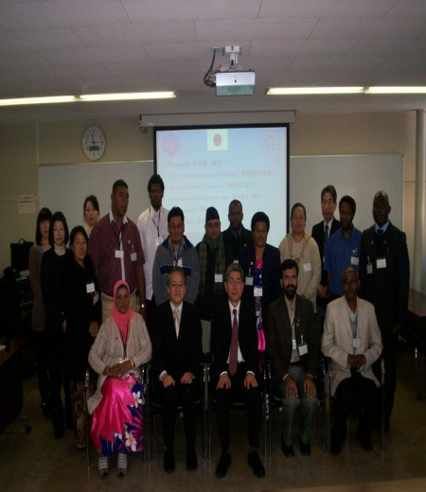
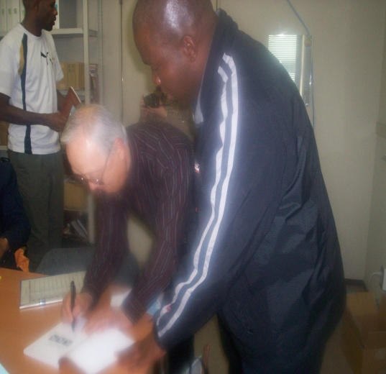
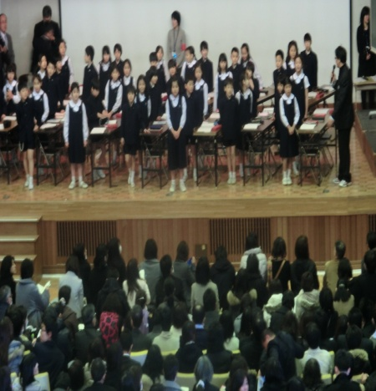
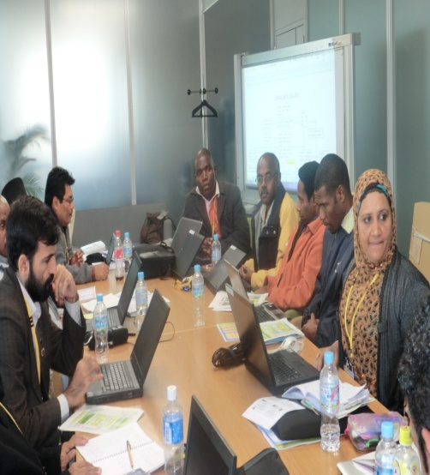
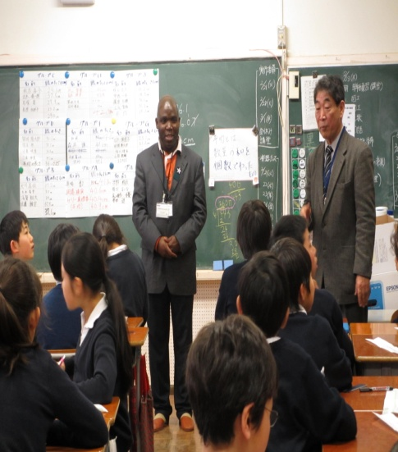
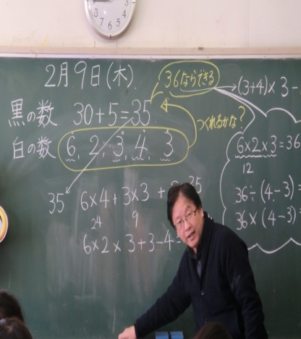
SOME OF THE HIGHLIGHTS IN JAPAN

Slide 12
THANK YOU!
NDI A LIVHUWA!
ARIGATO GOZAIMUSU

